Slide 1
Everyday AI!
https://bit.ly/soma-second-draft
Jonathan Soma
Knight Chair in Data Journalism
Columbia University Graduate School of Journalism
jonathansoma.com ⠿ @dangerscarf ⠿ js4571@columbia.edu

Slide 2
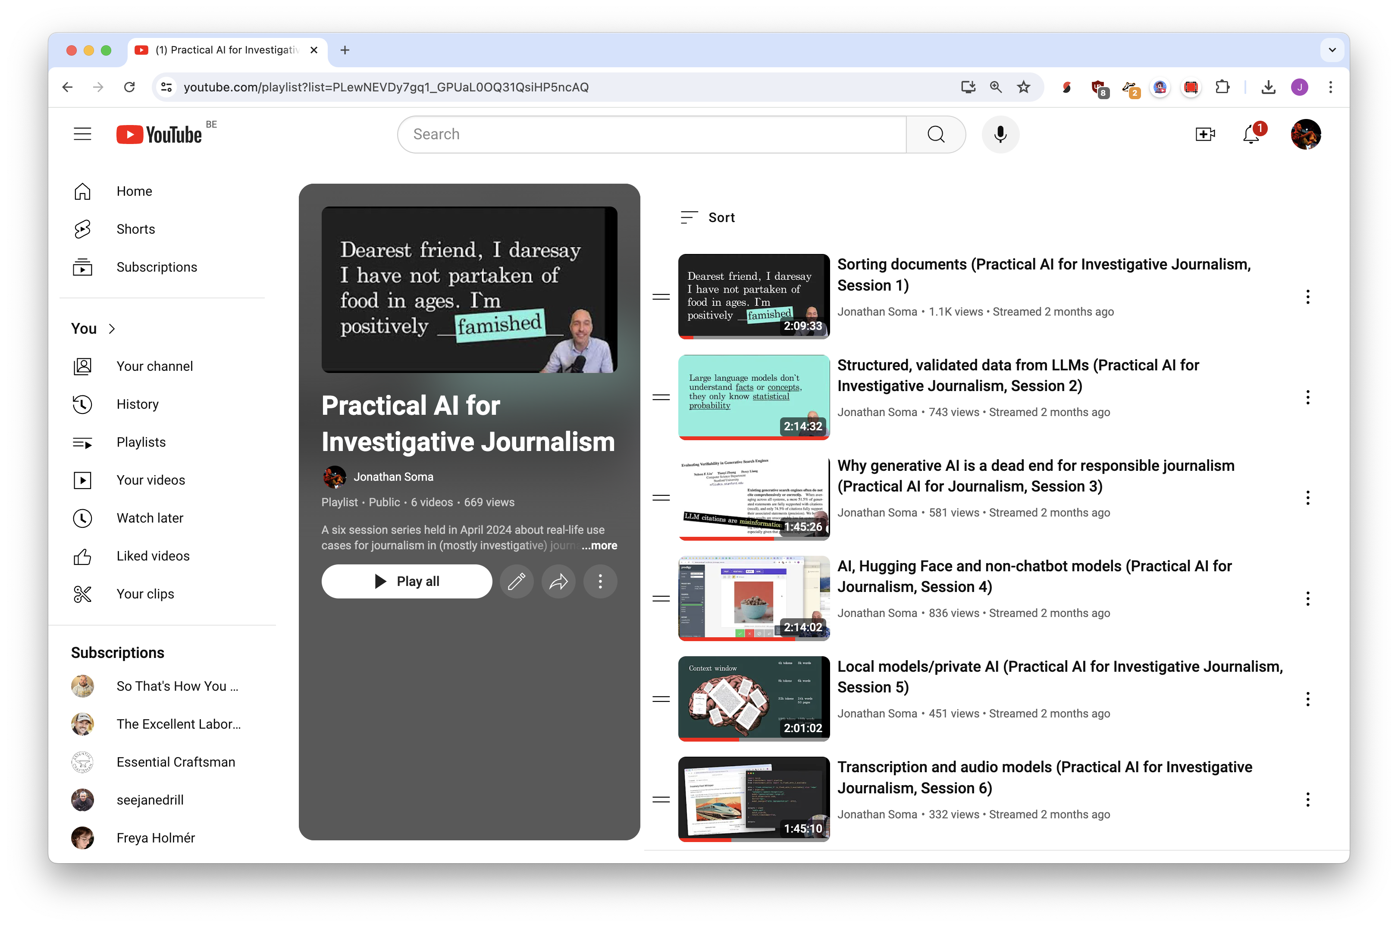

Slide 3
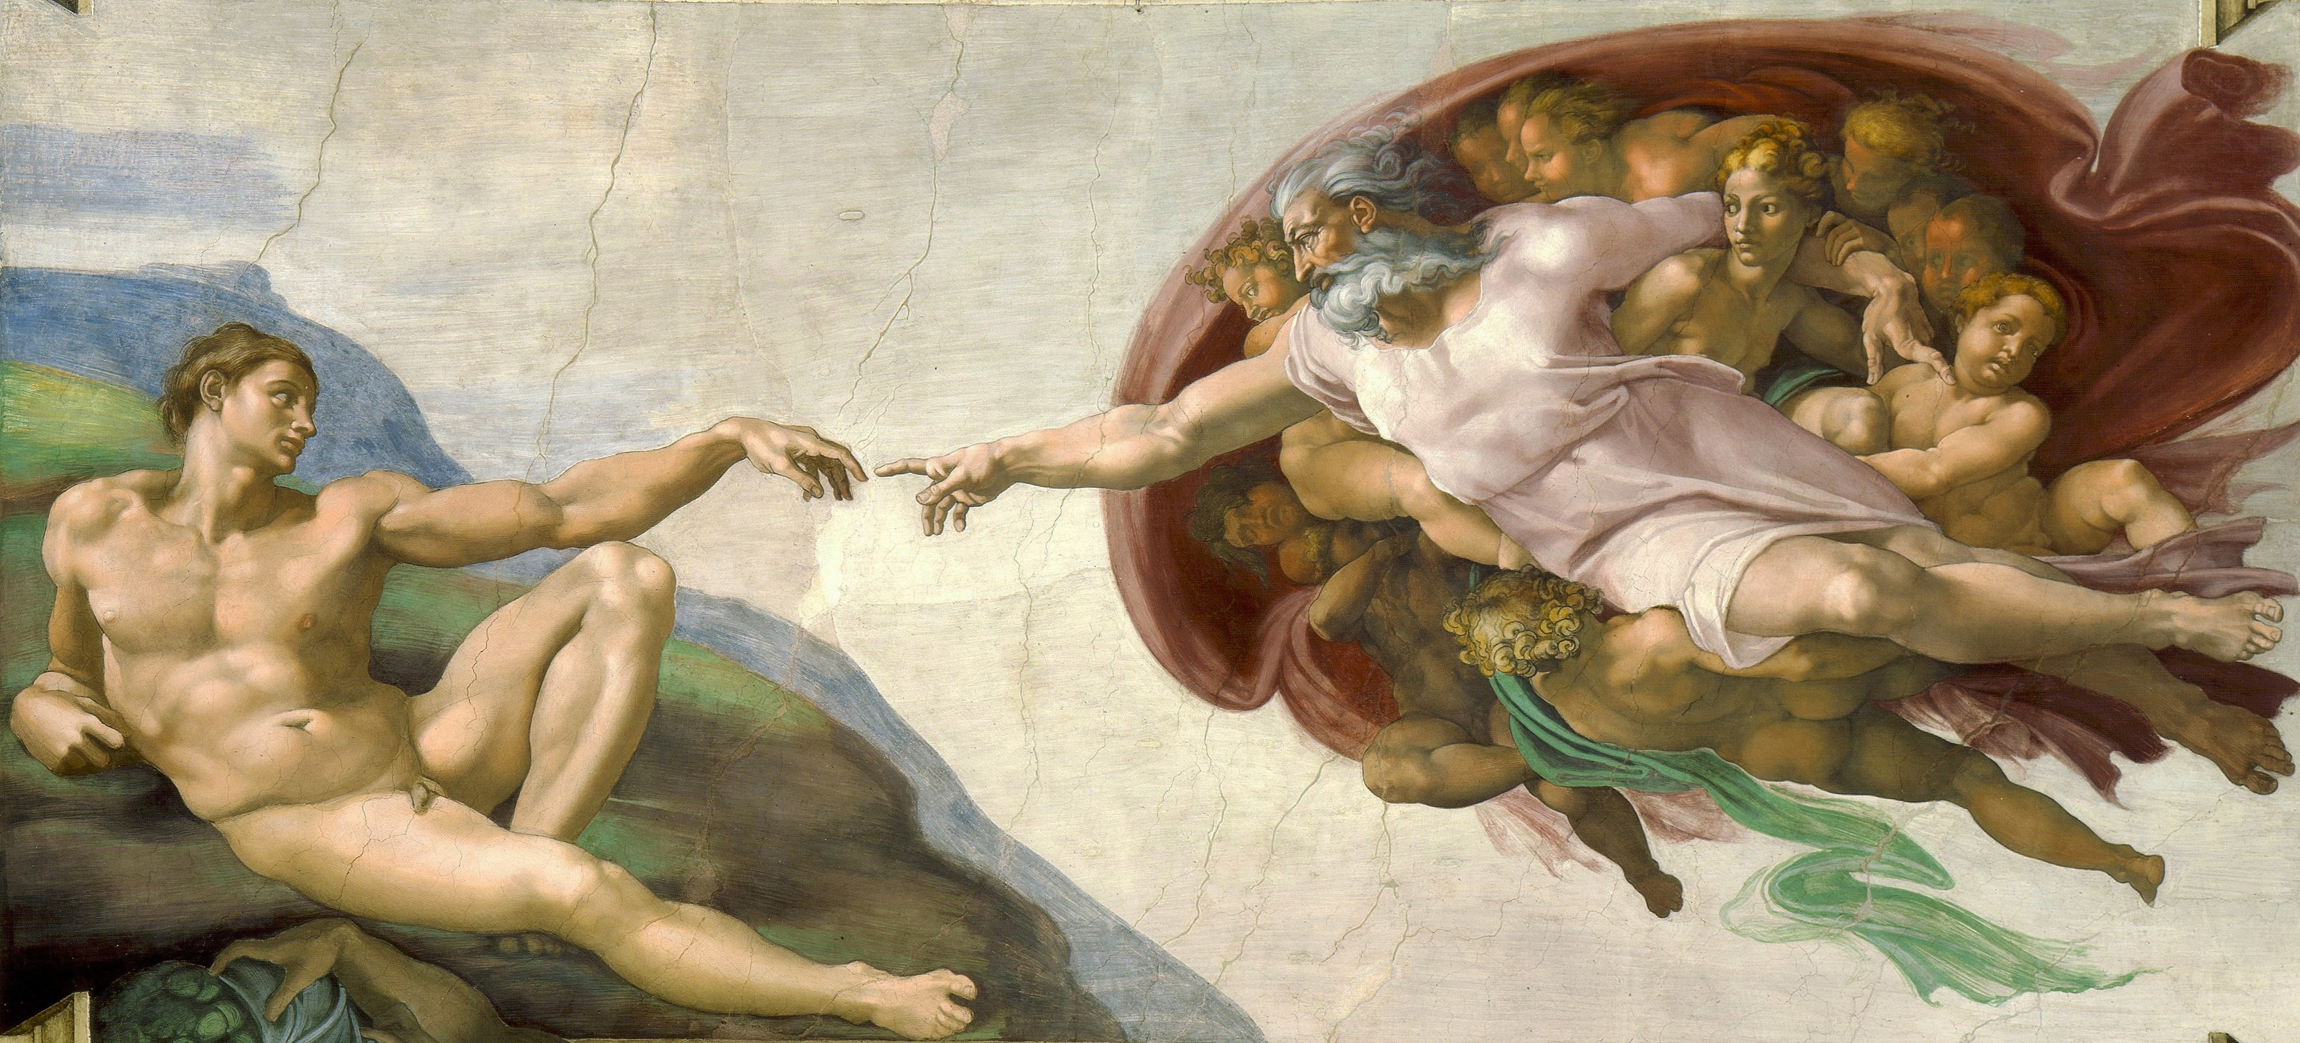
A.I.

Slide 4

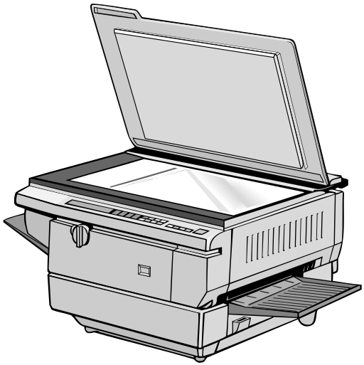
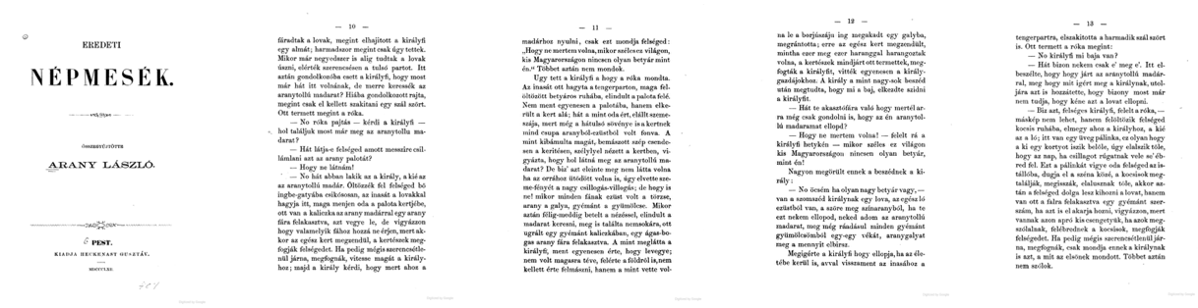

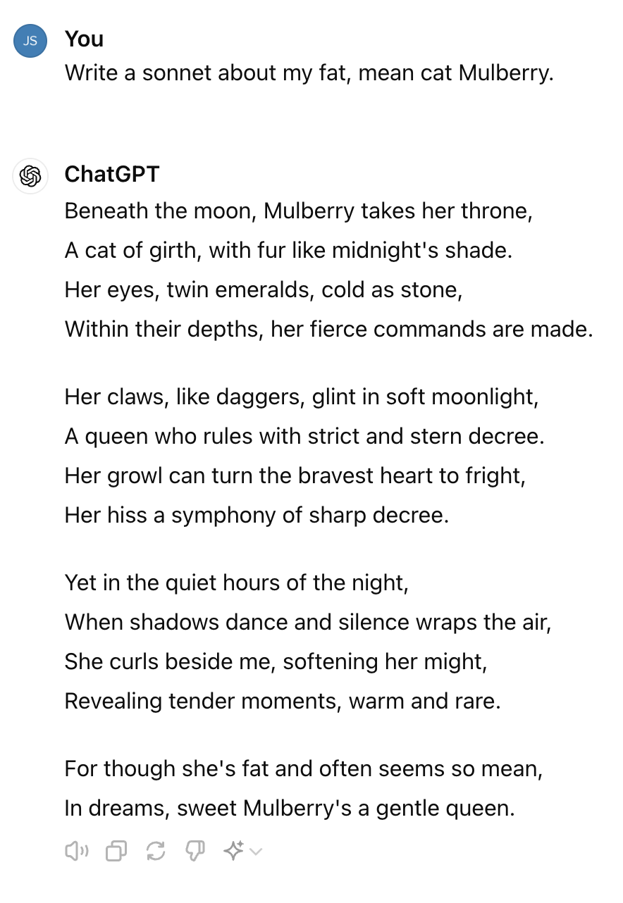
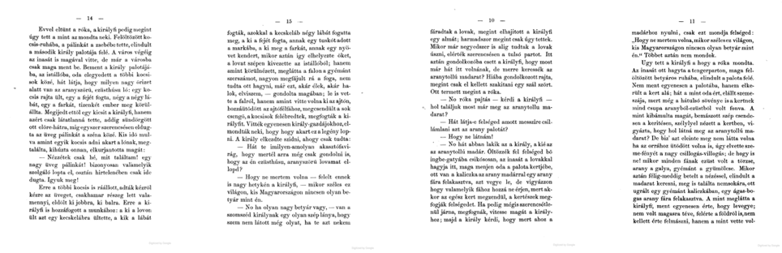
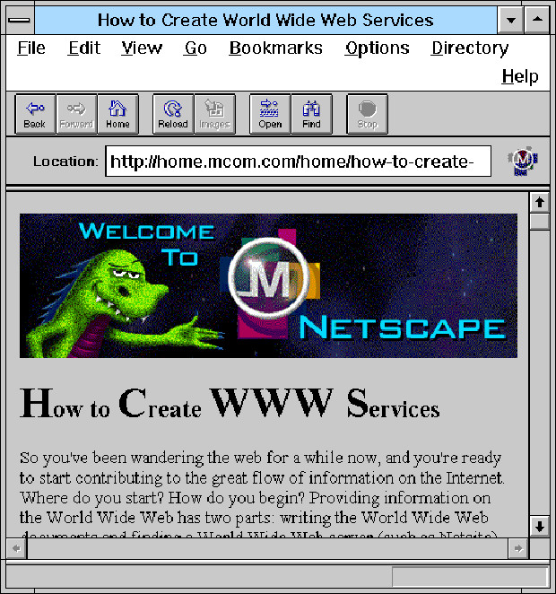




Slide 5
Large language models don’t understand facts or concepts, they only know statistical probability

Slide 6
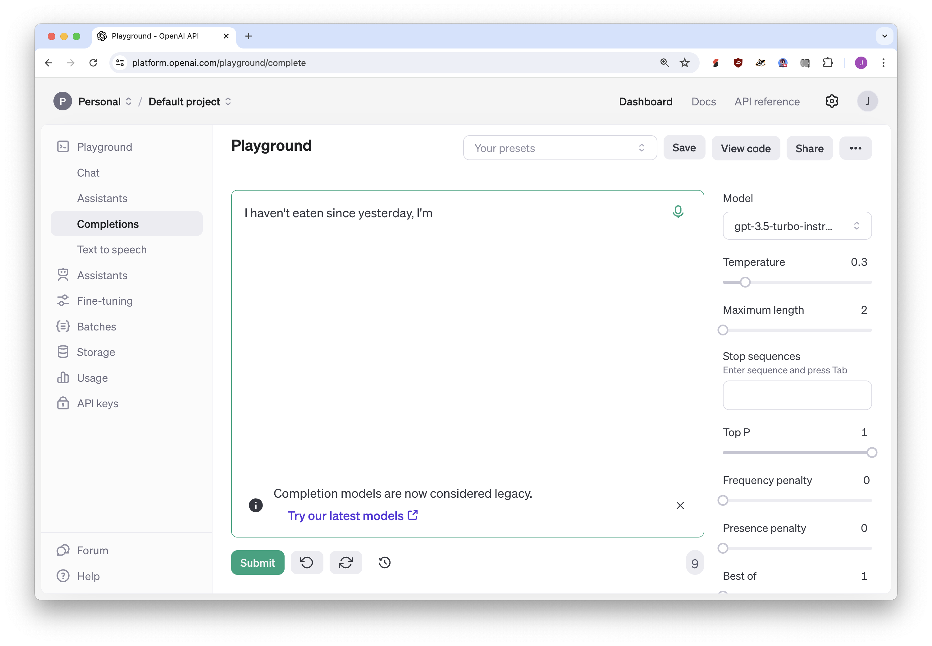
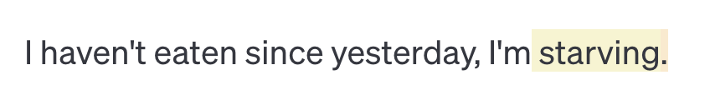
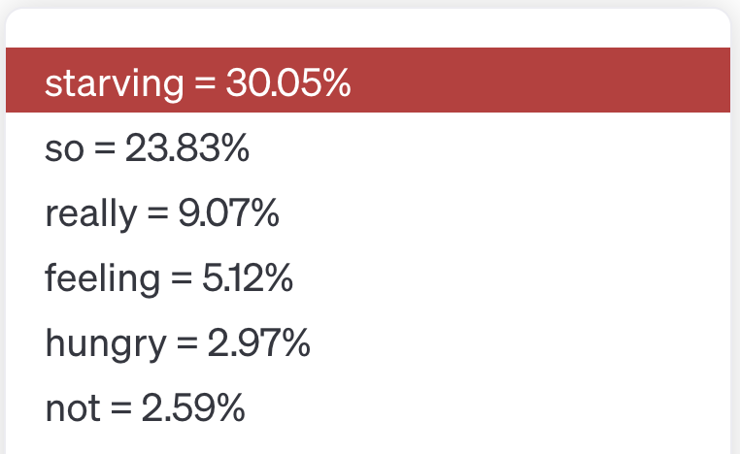

Slide 7
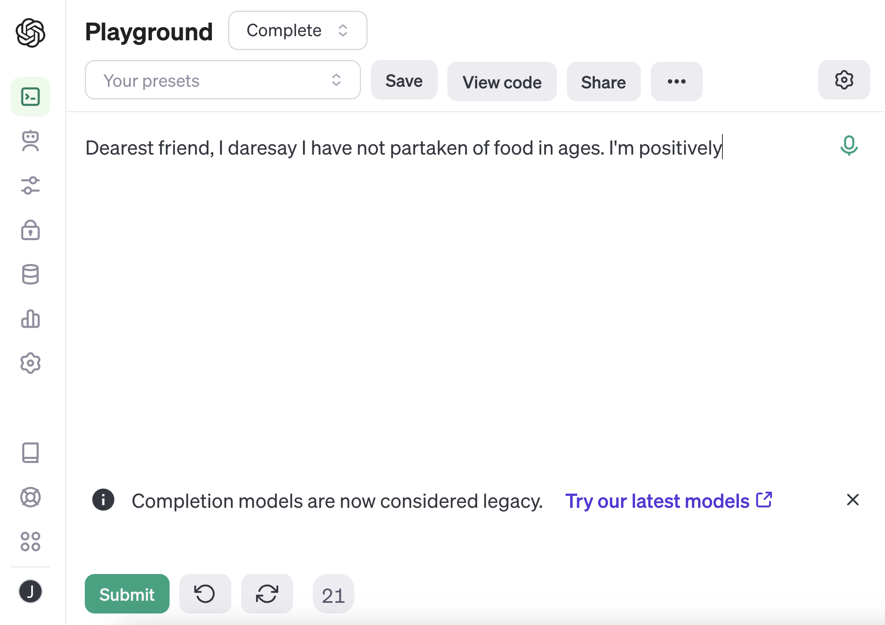

Slide 8
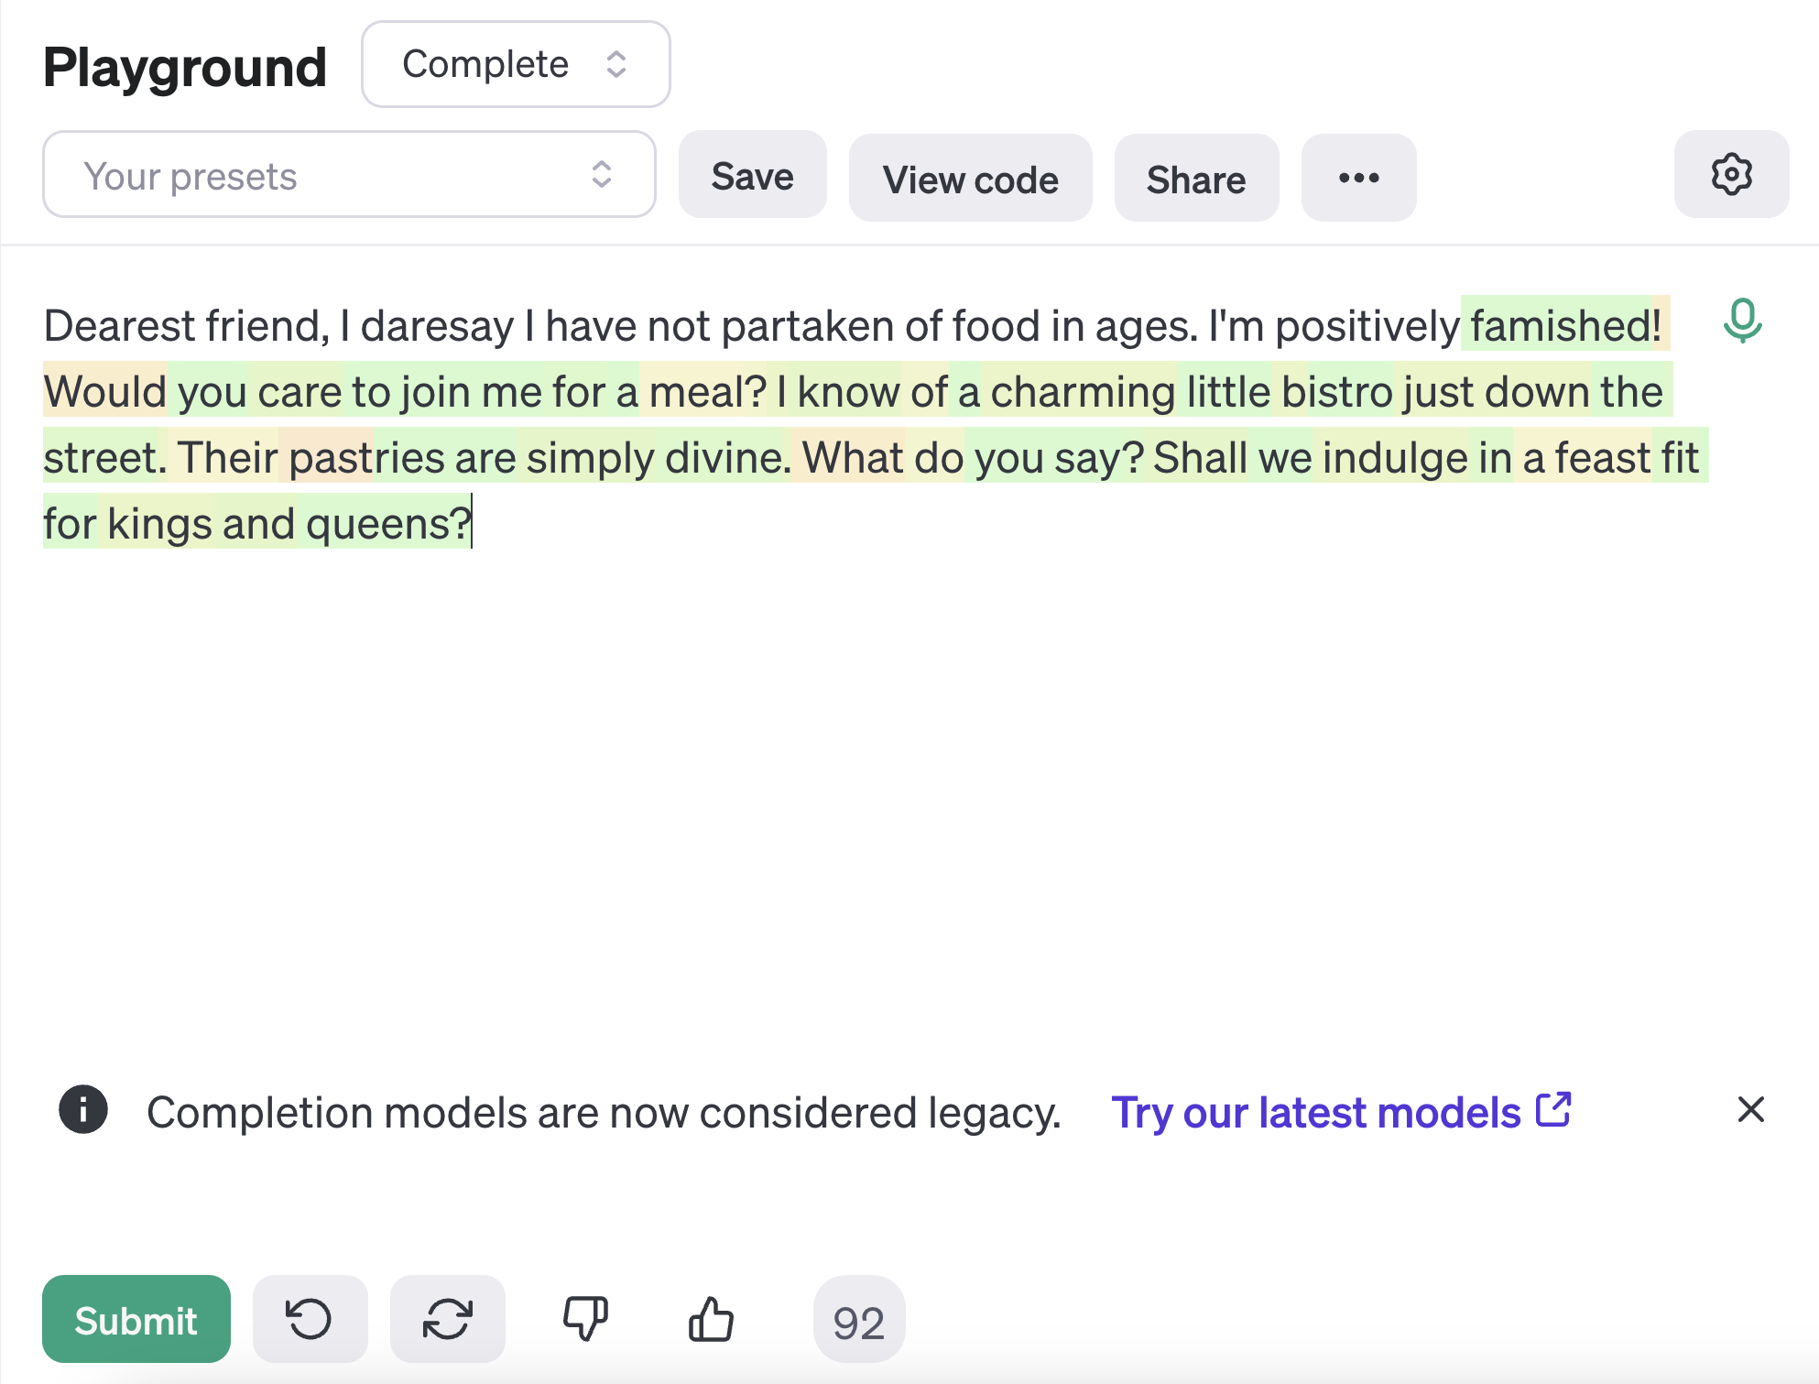

Slide 9
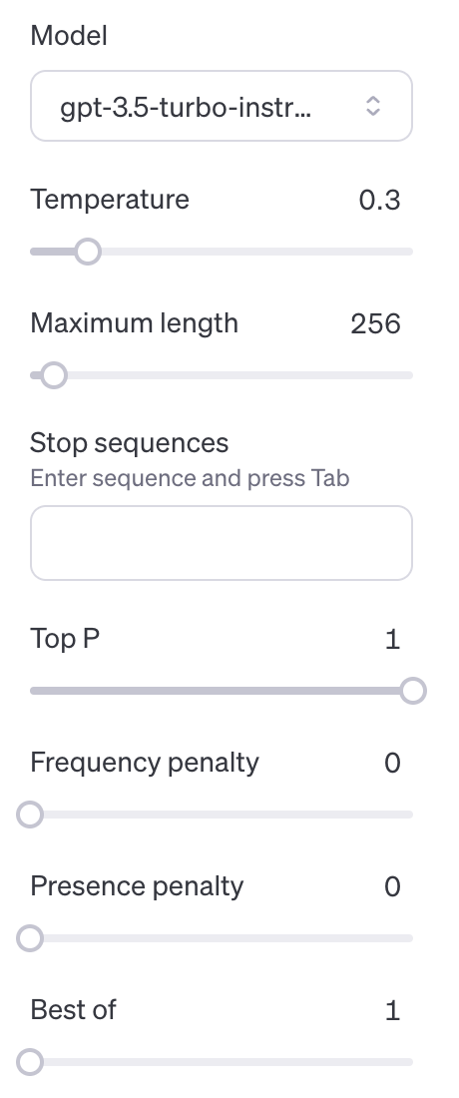


Slide 10
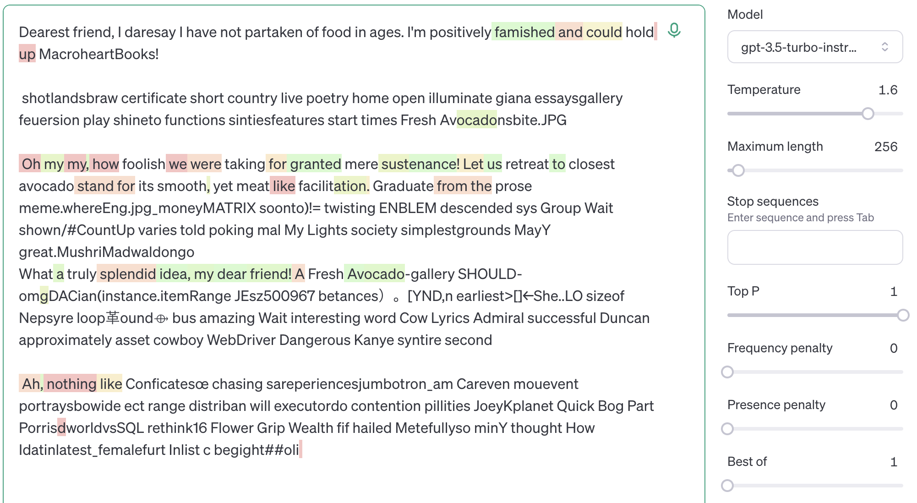


Slide 11
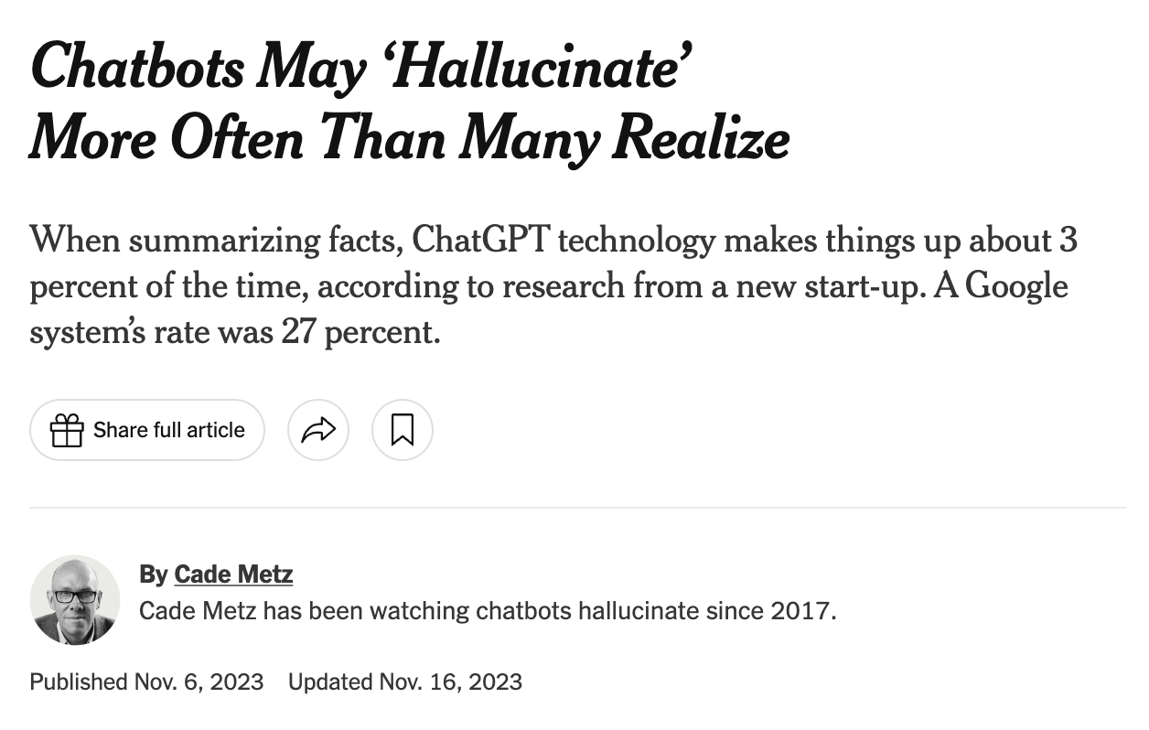

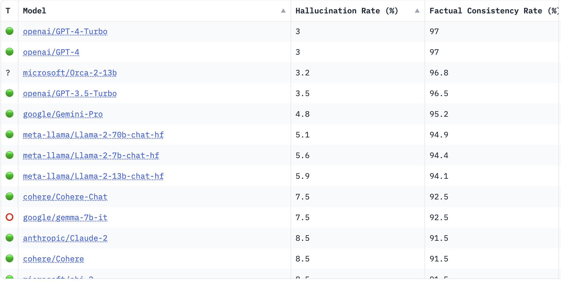

Slide 12
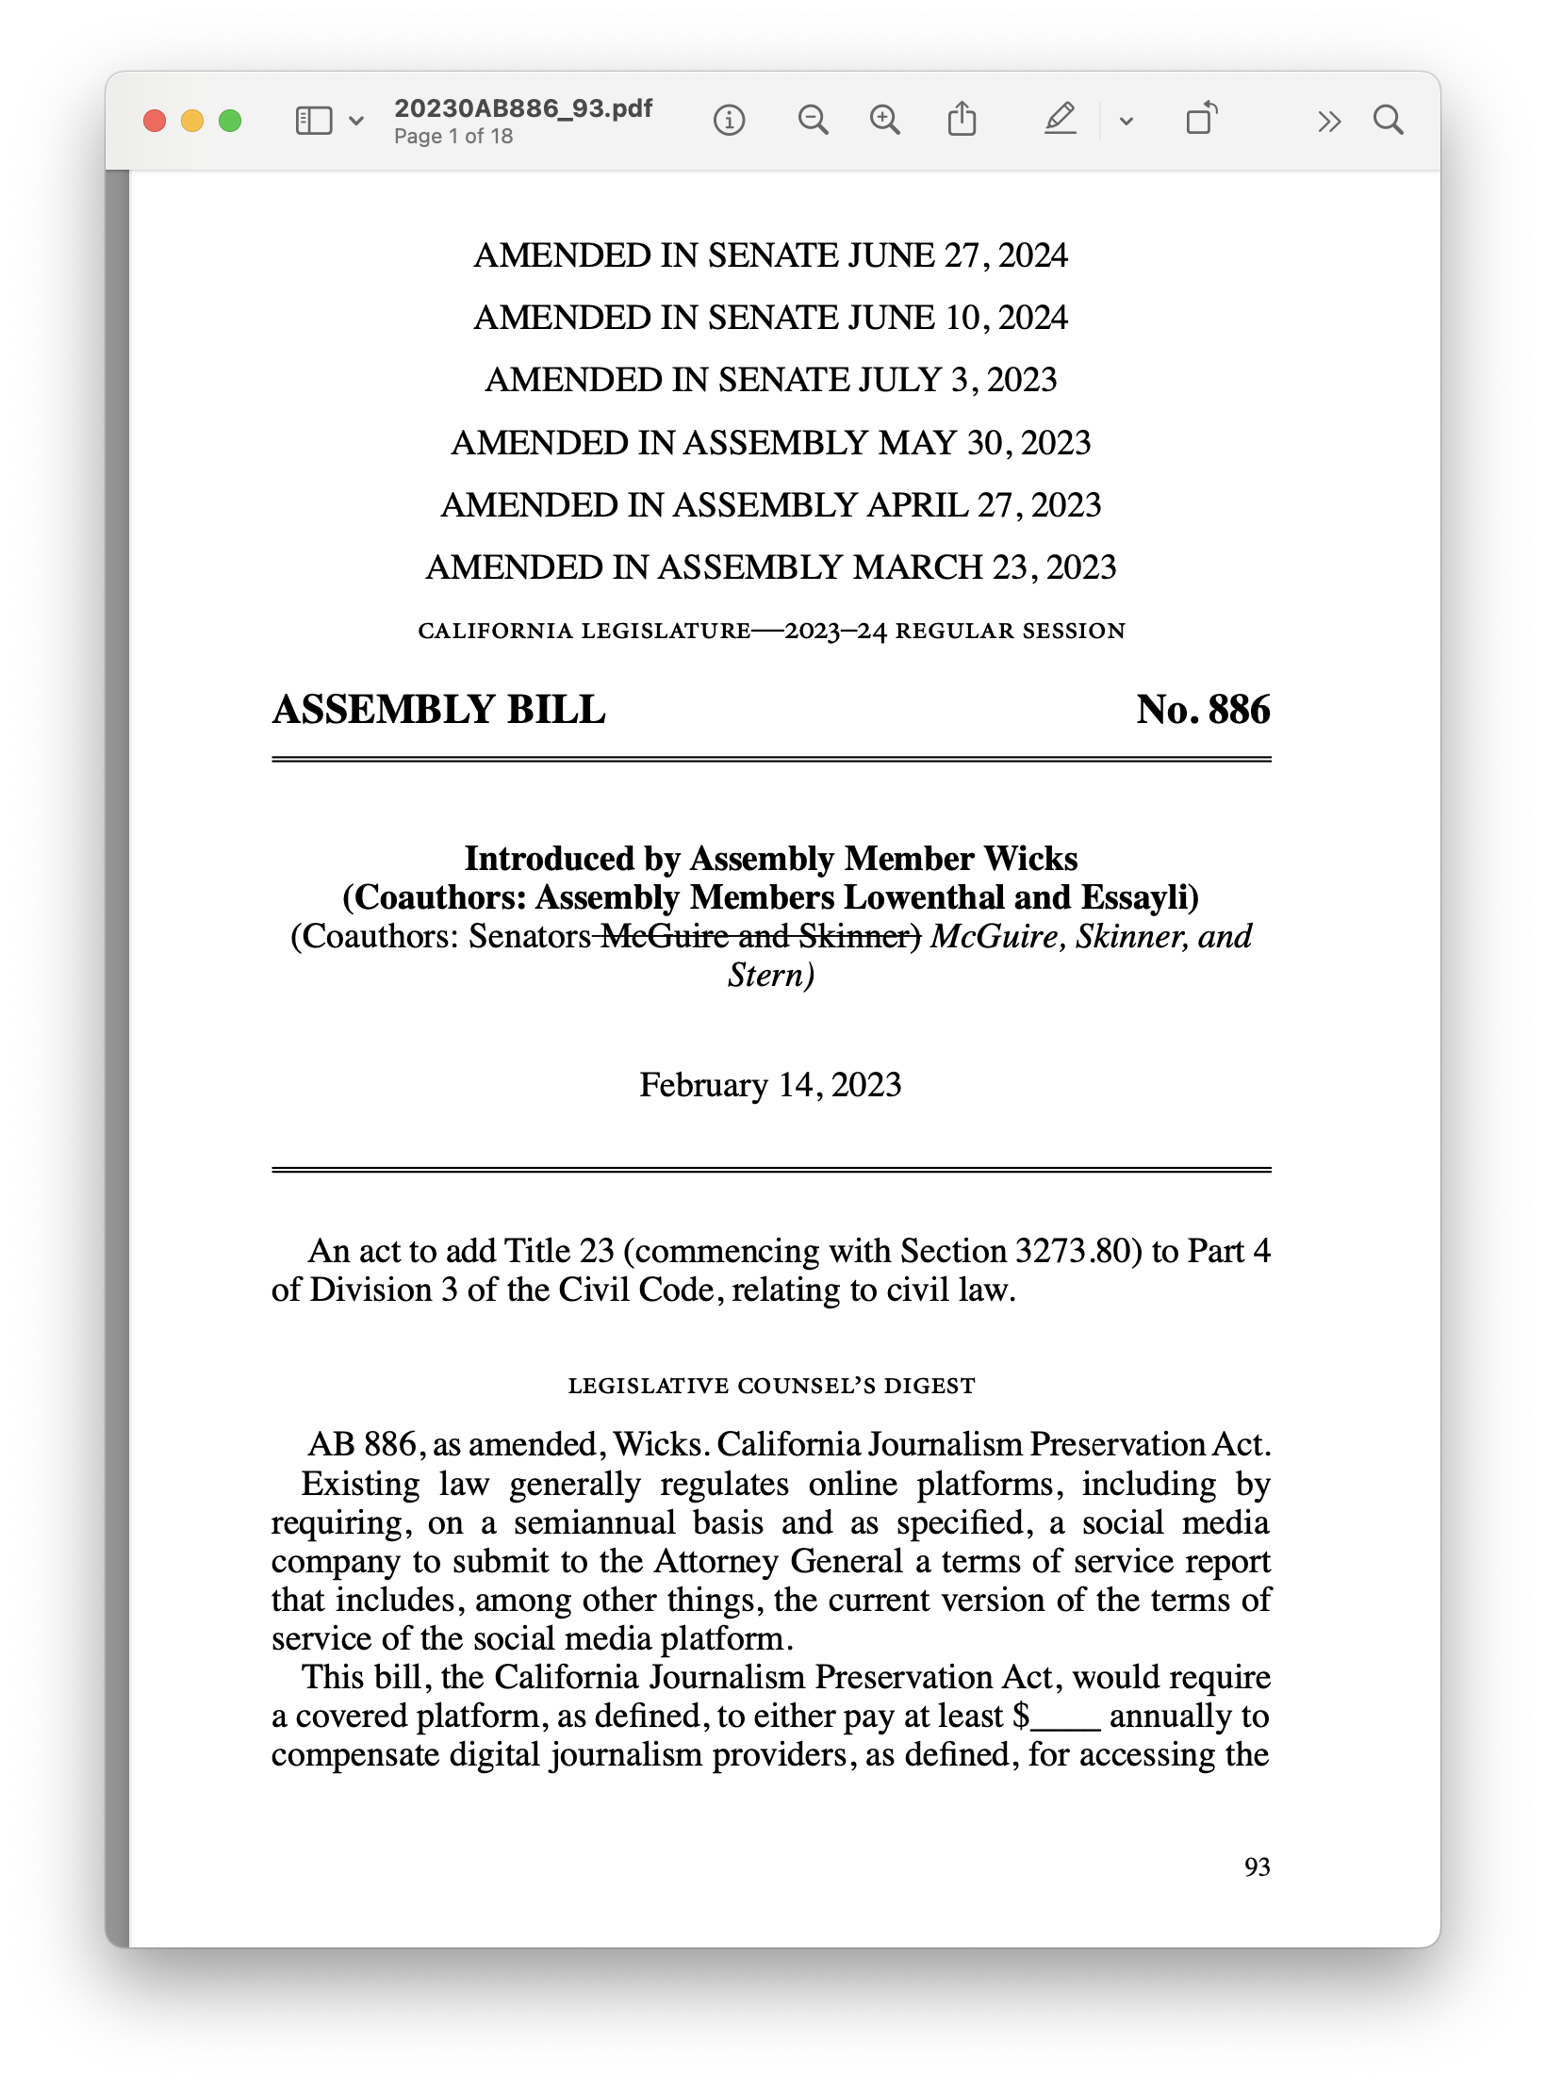

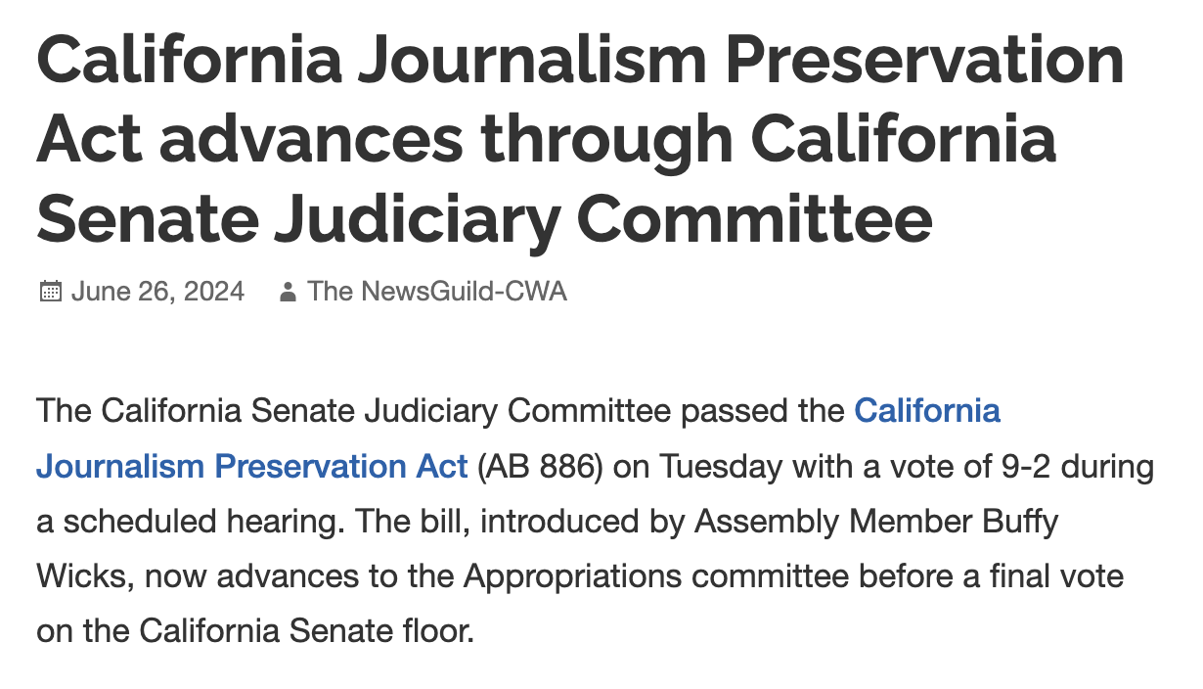

Slide 13
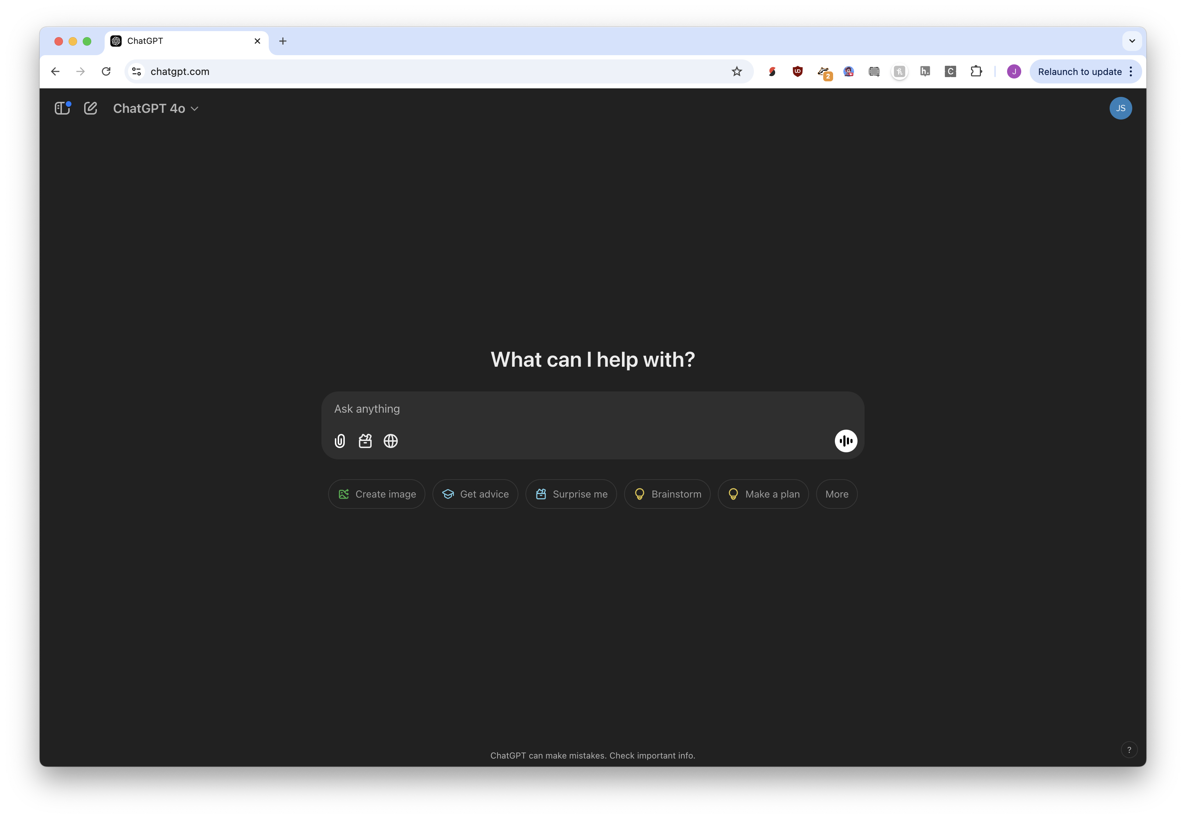



Slide 14
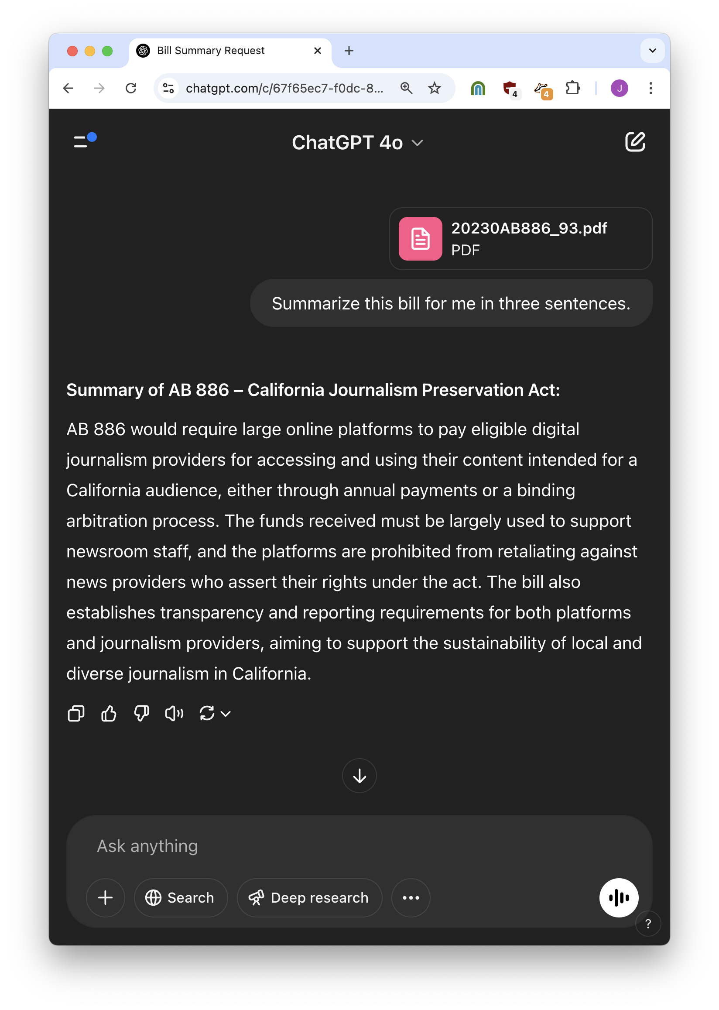


Slide 15
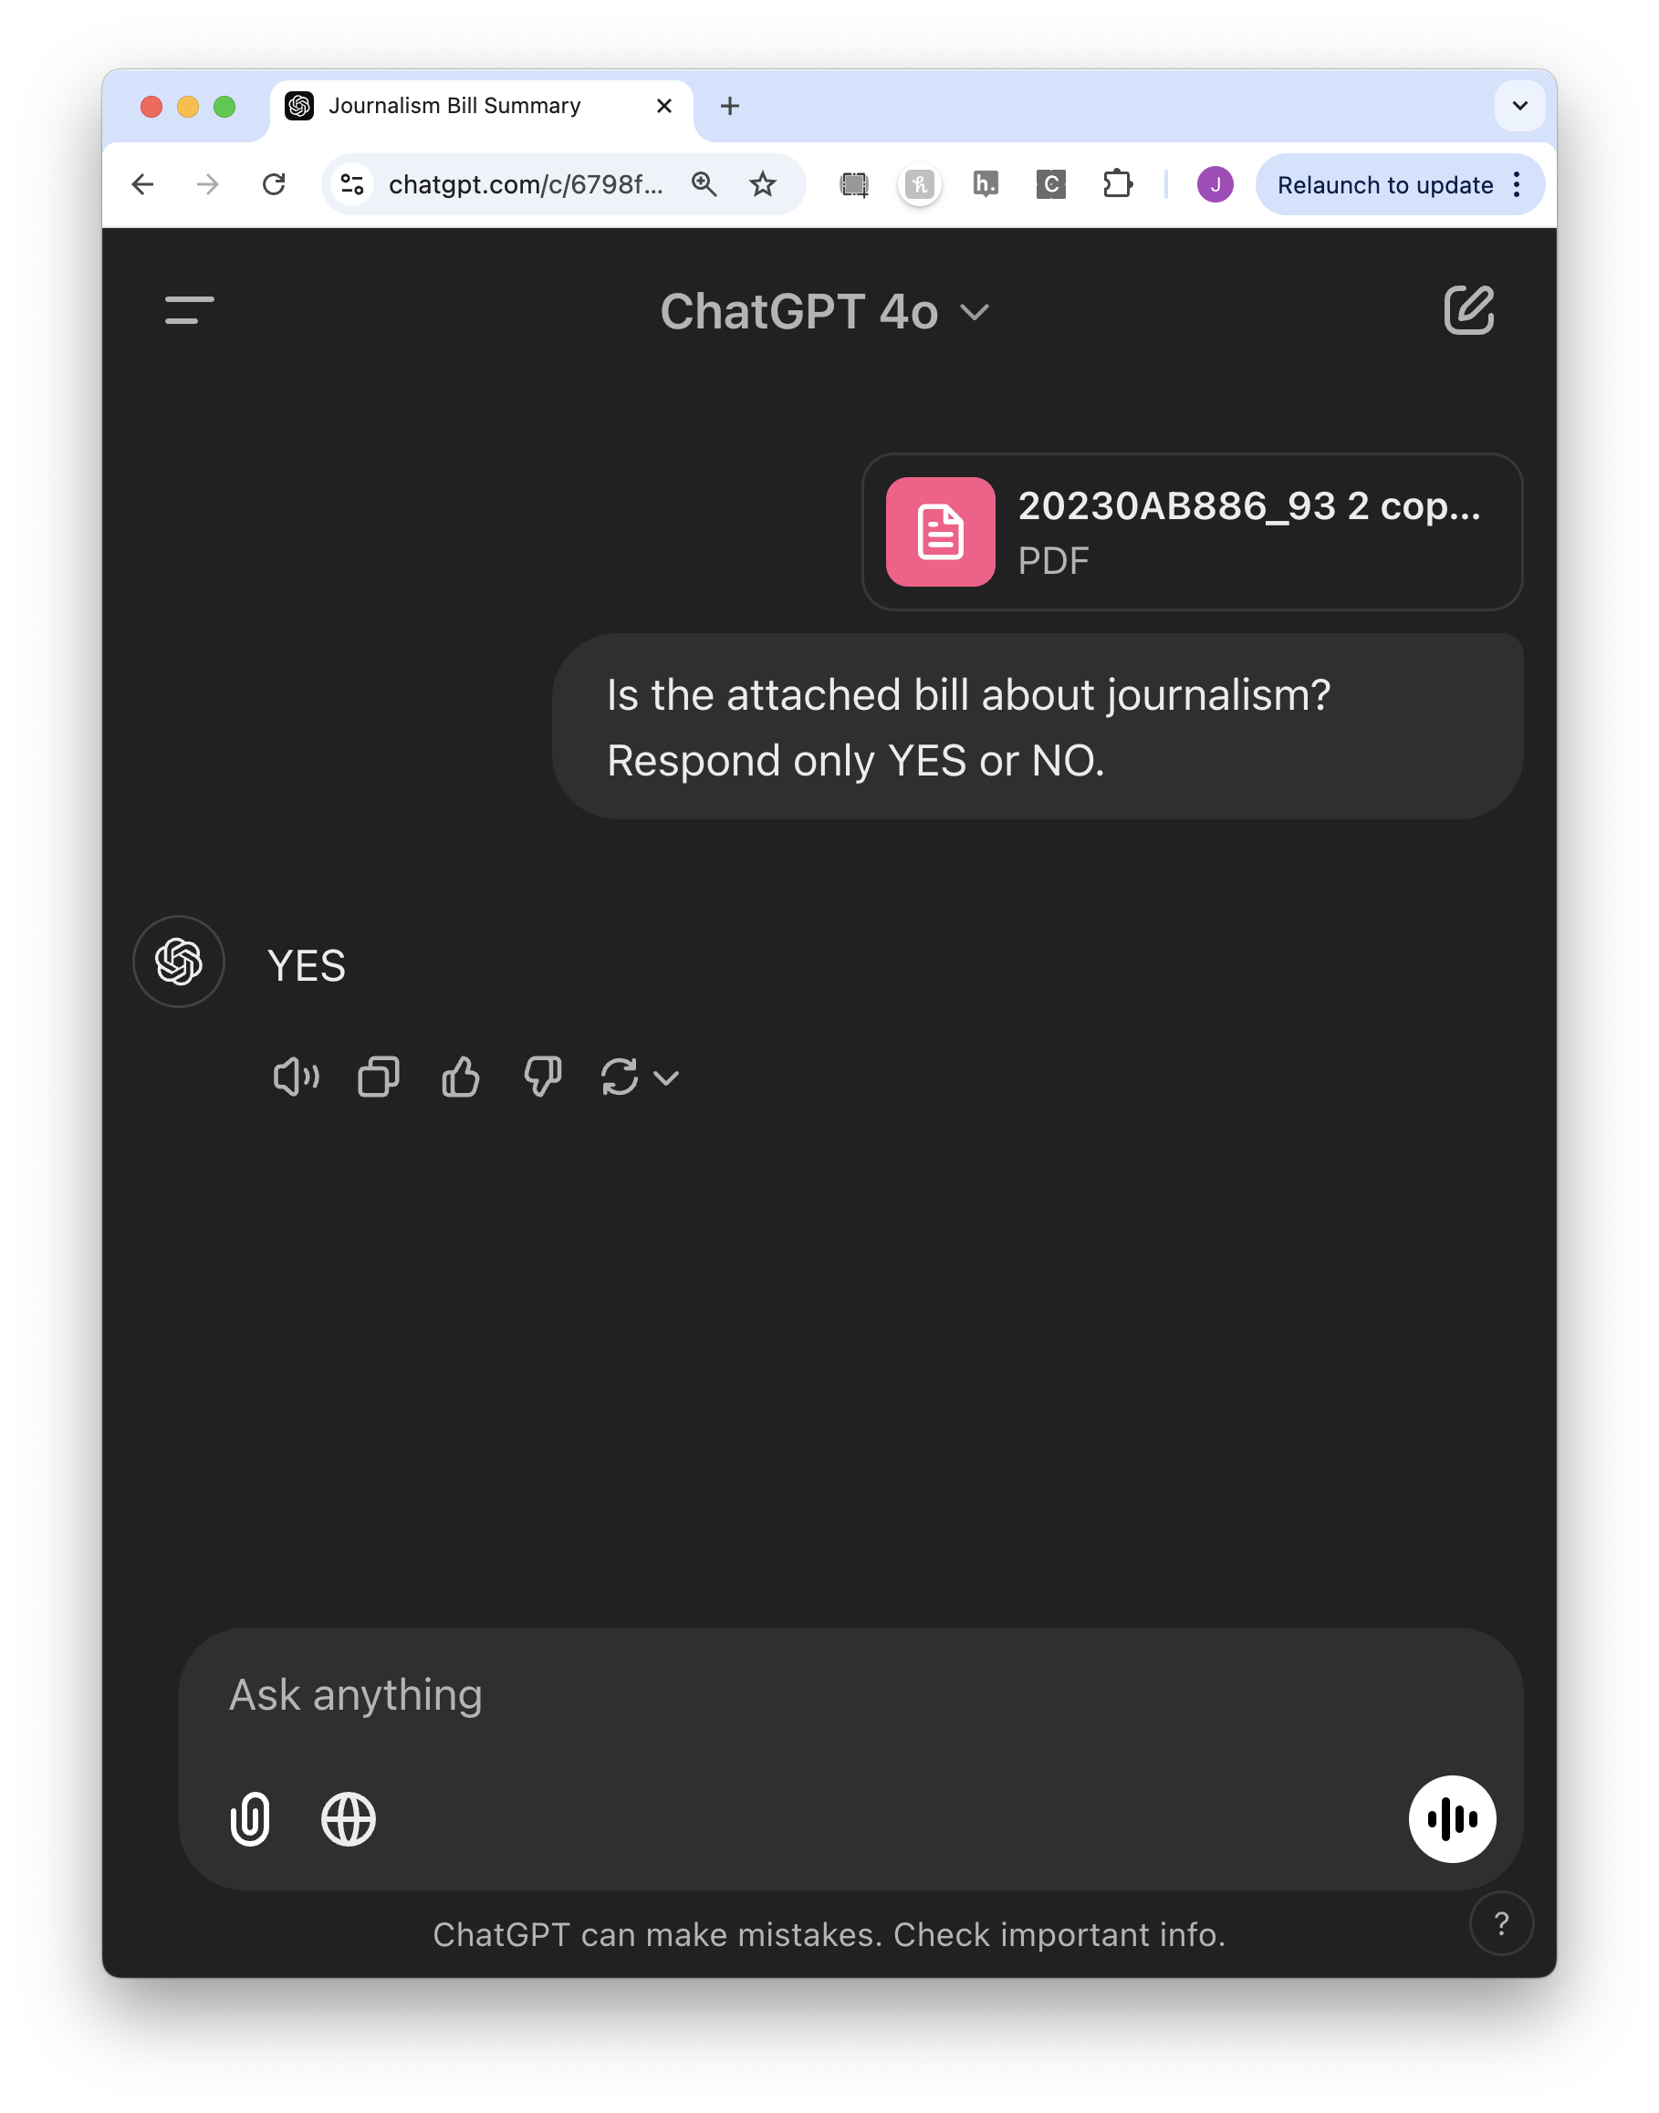

Slide 16
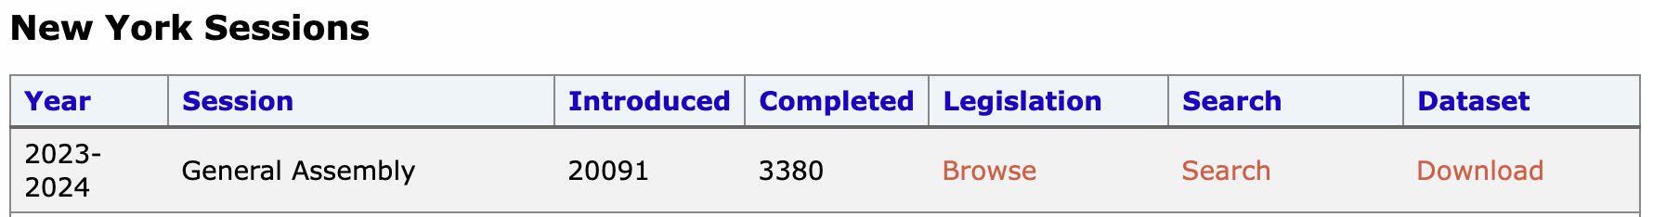
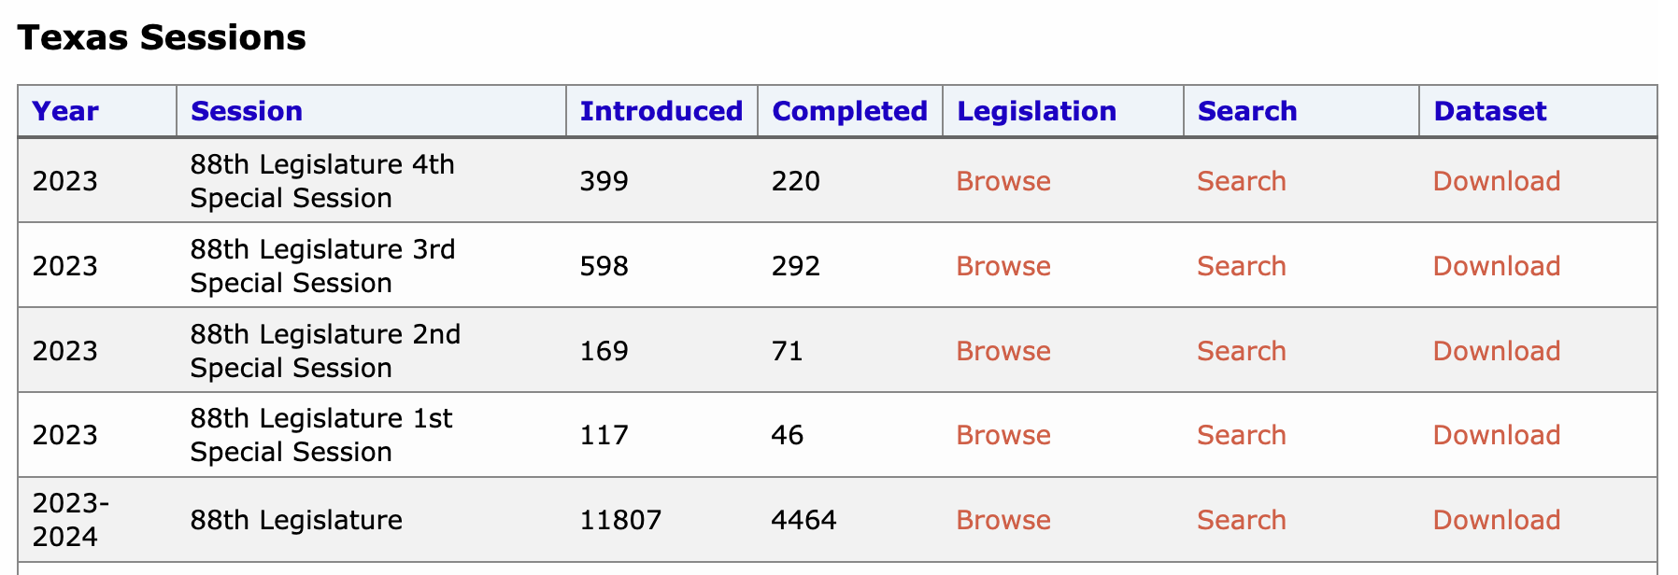

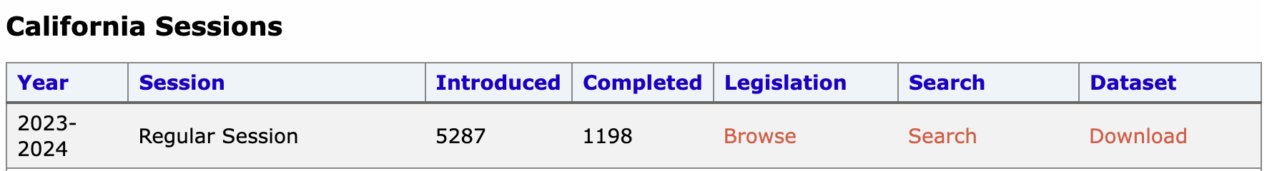

Slide 17
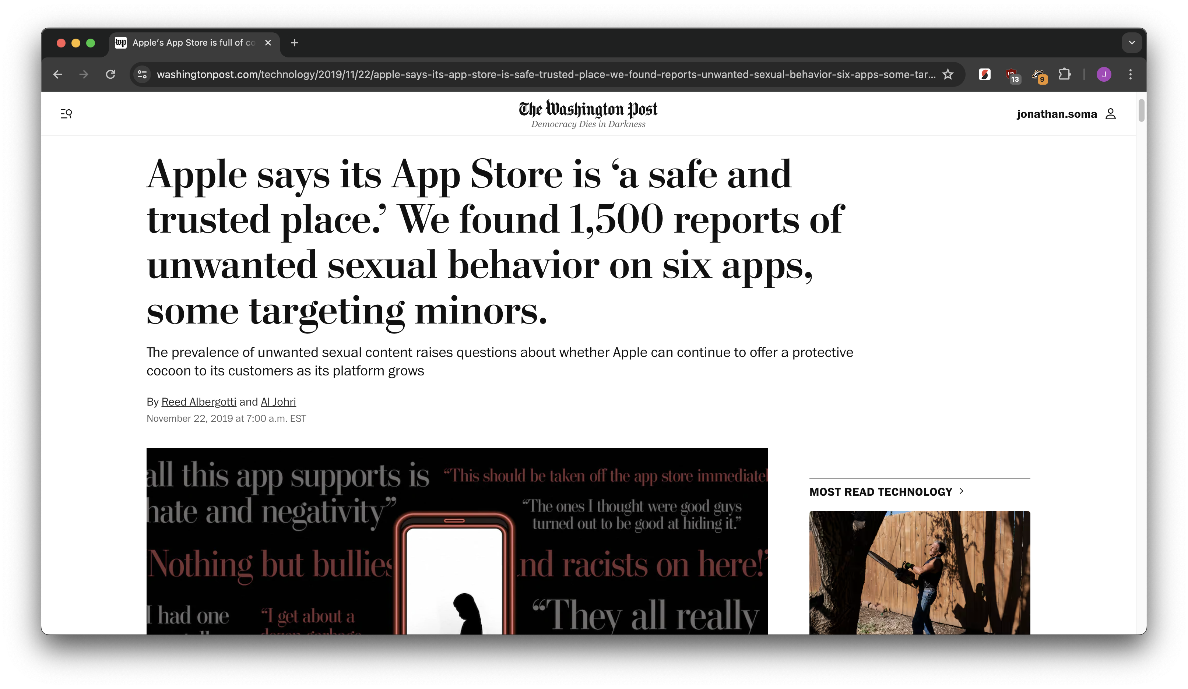
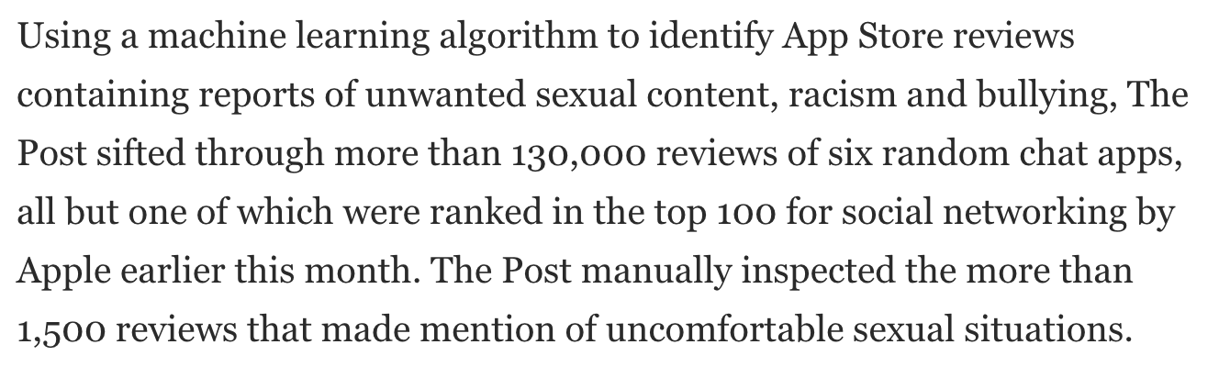
an example

Slide 18
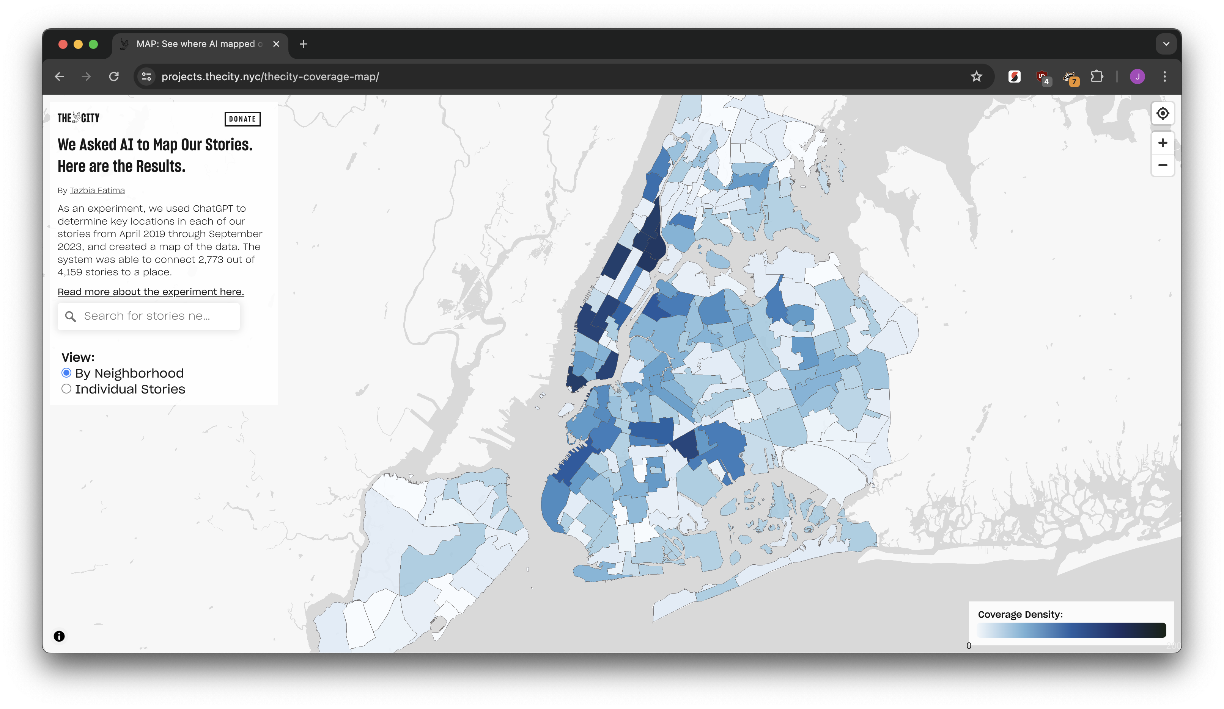
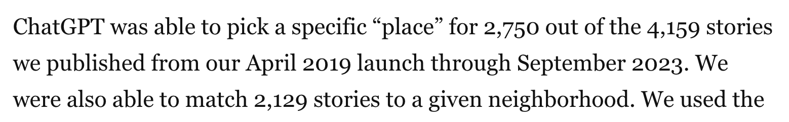
an example

Slide 19

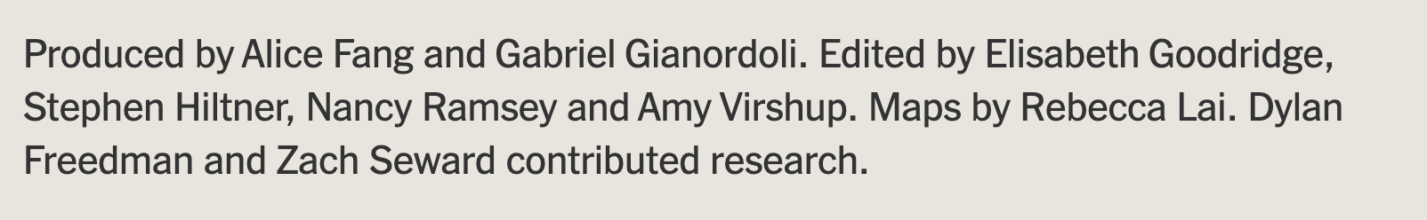
an example

Slide 20






Slide 21
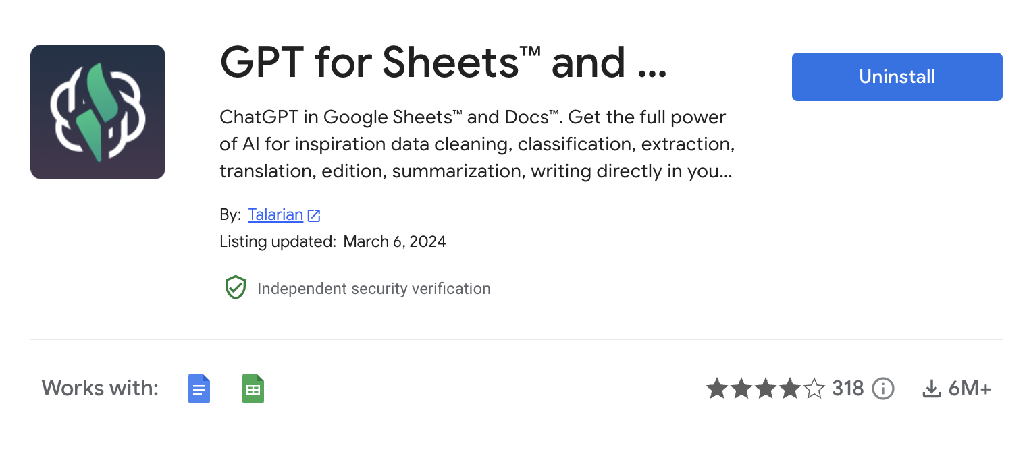

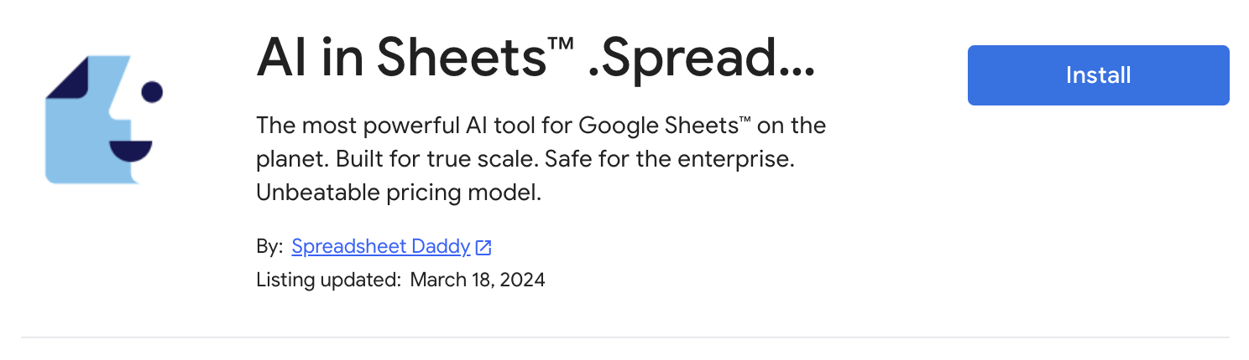

Slide 22
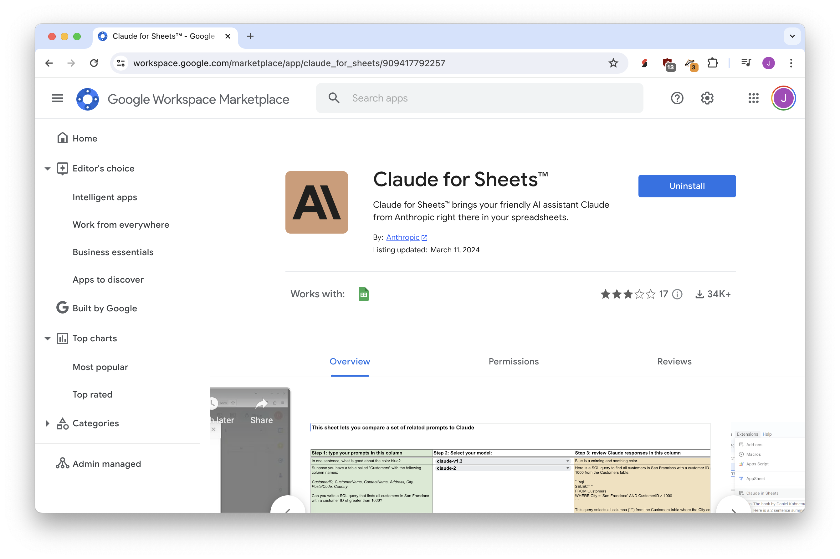

Slide 23
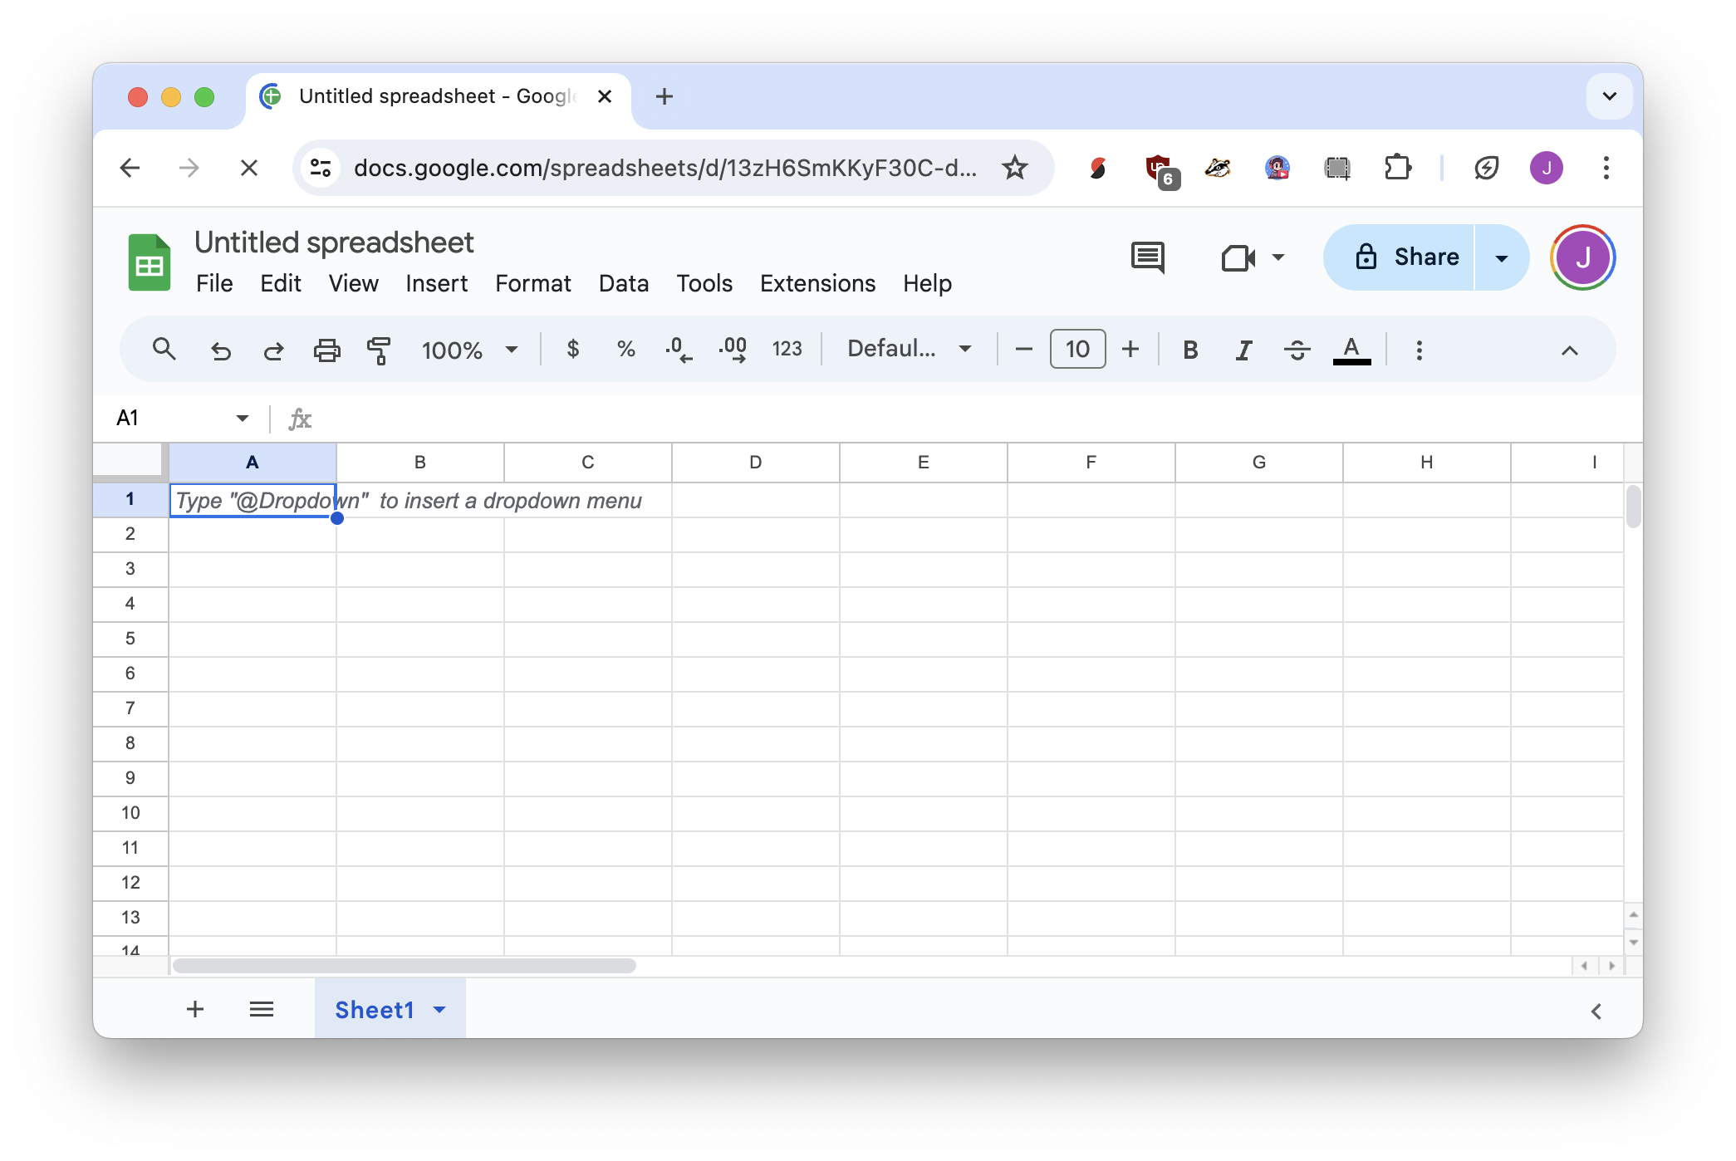
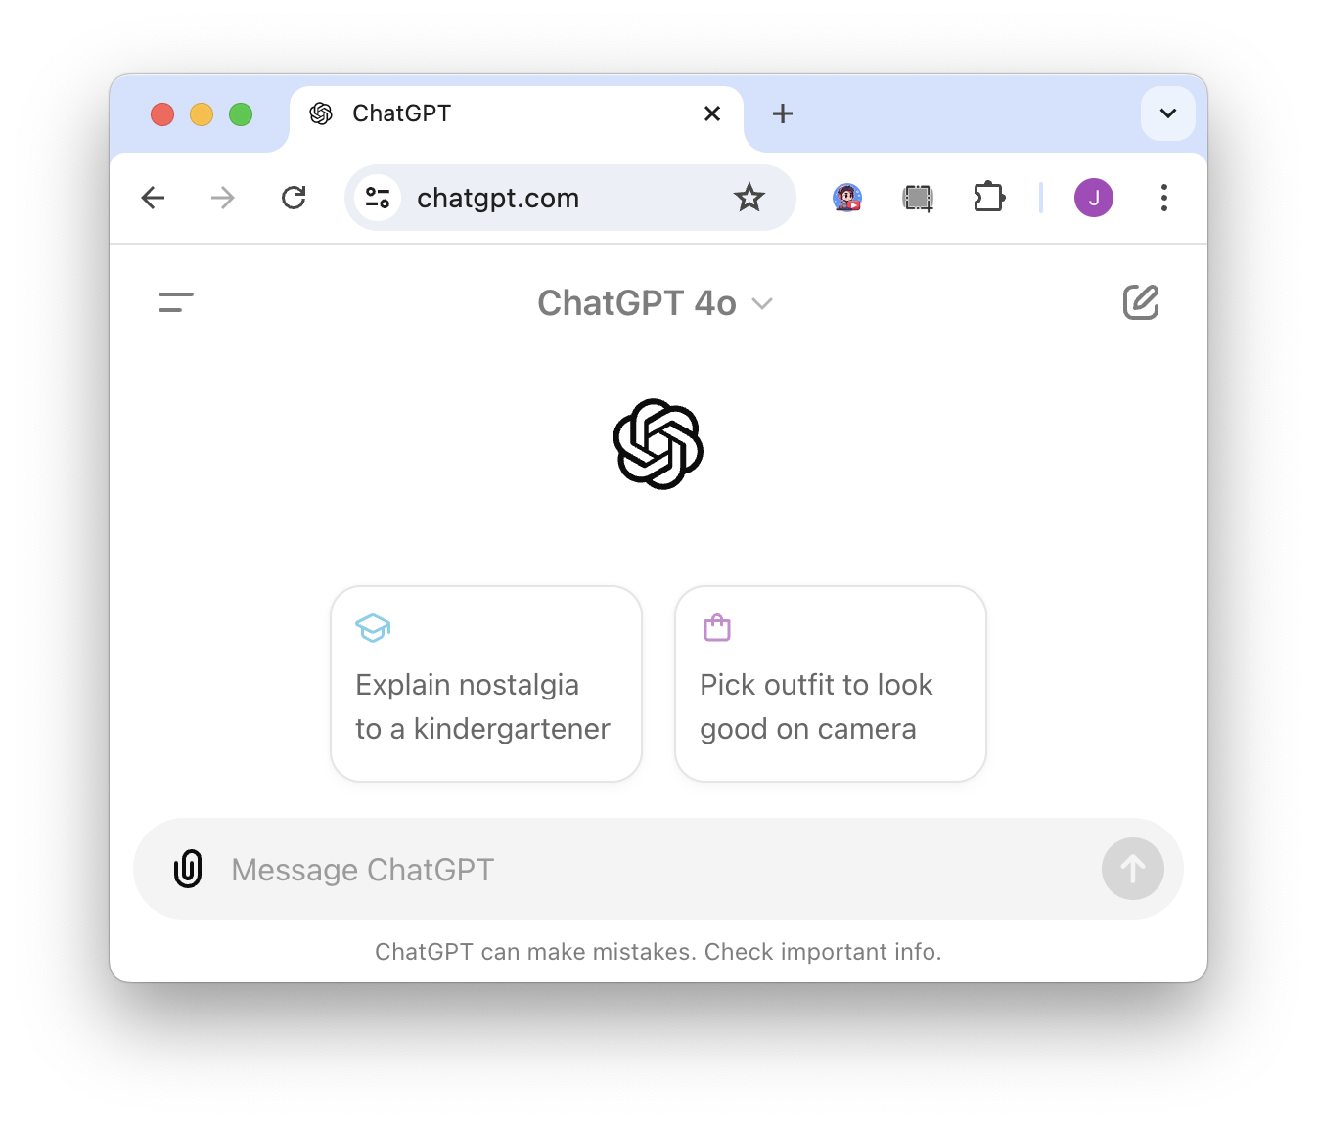



asks question
gives answer

Slide 24
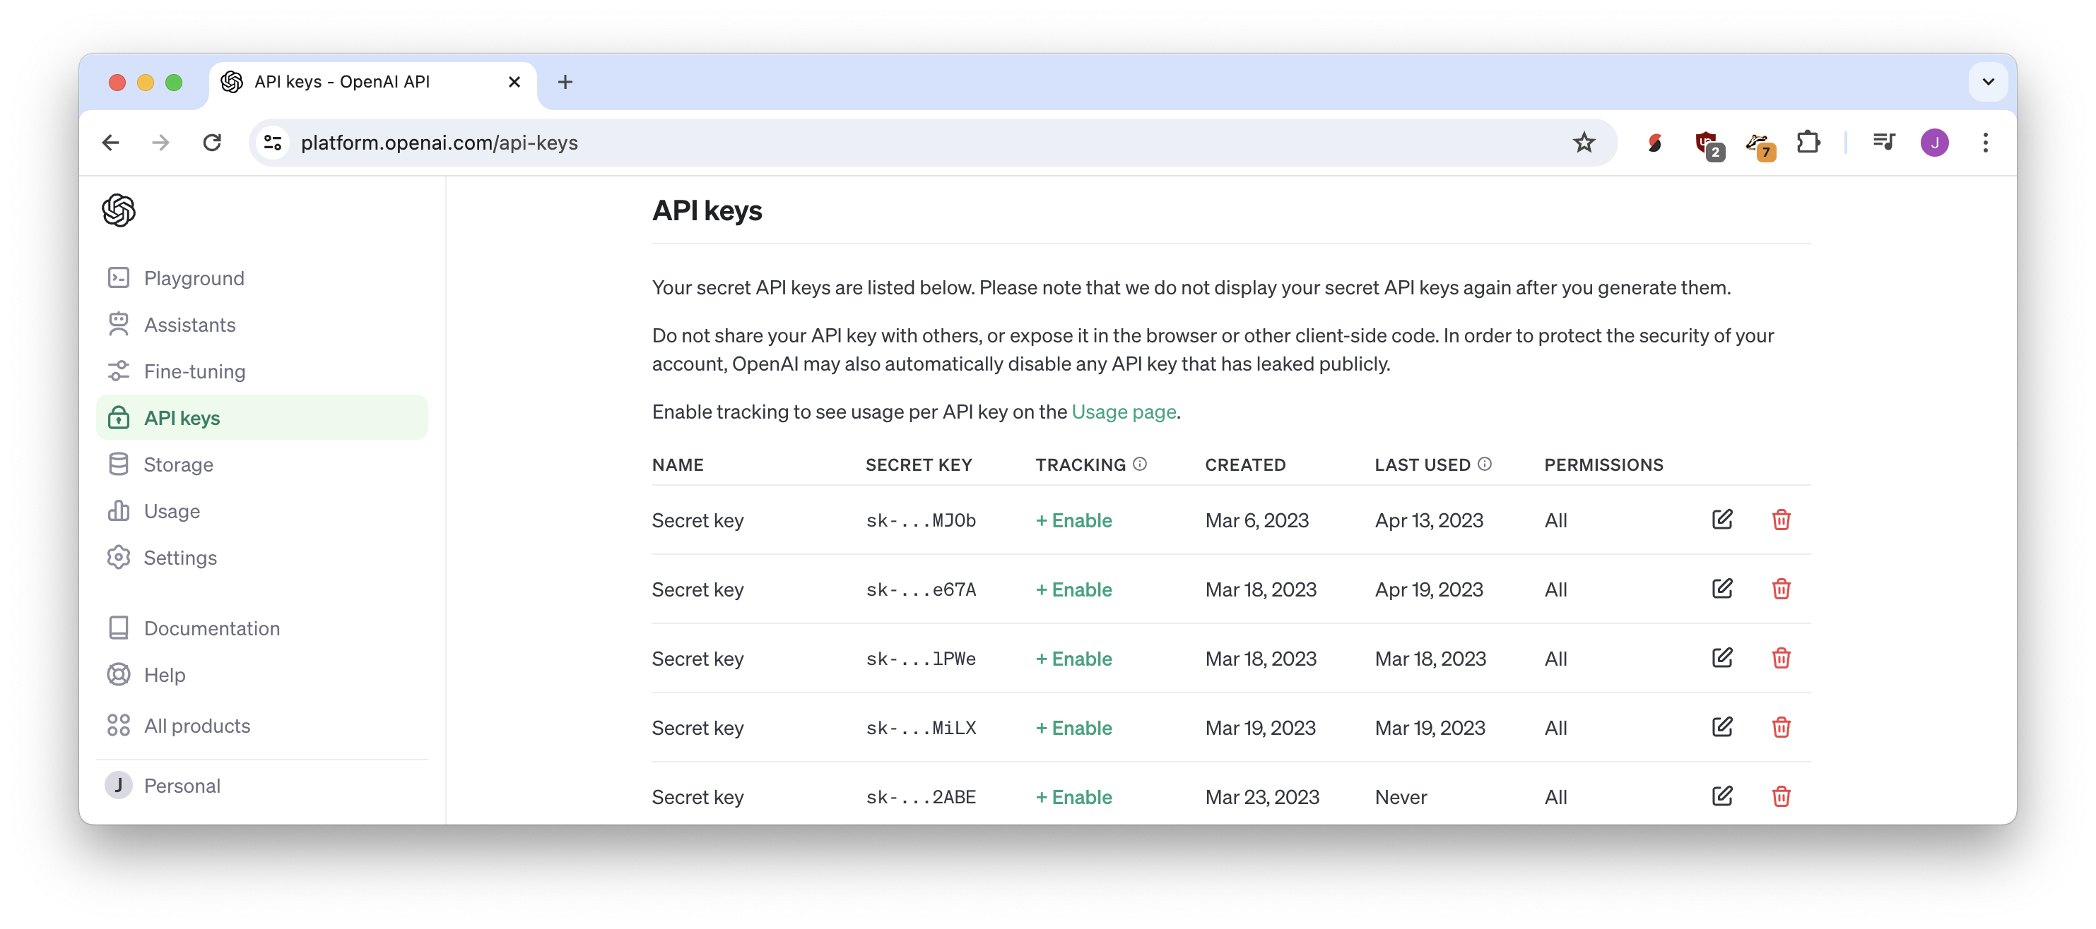
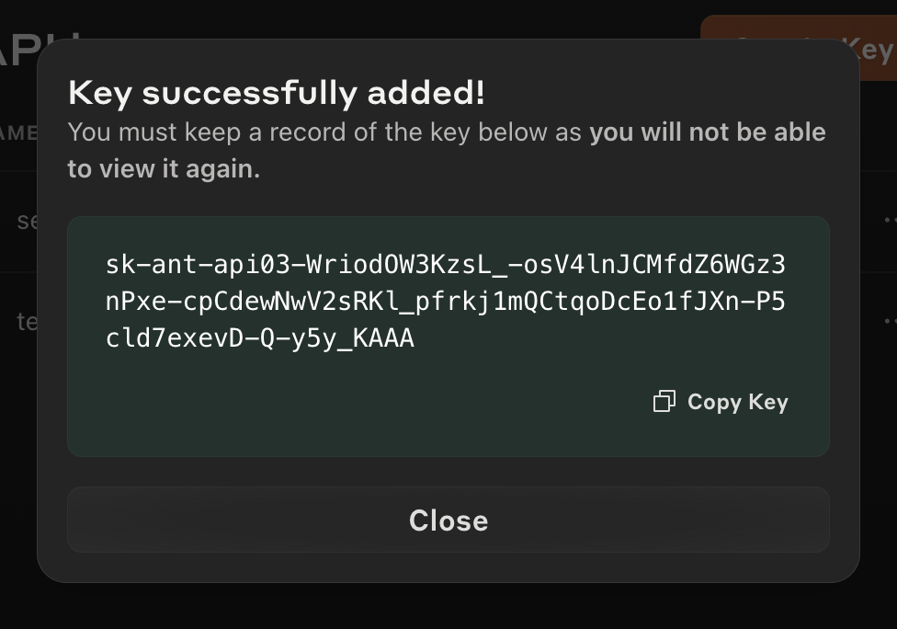
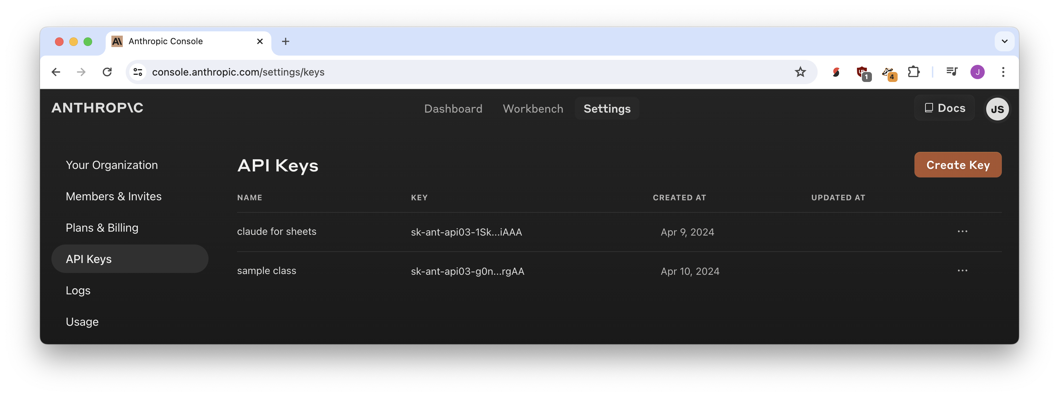
API keys

Slide 25
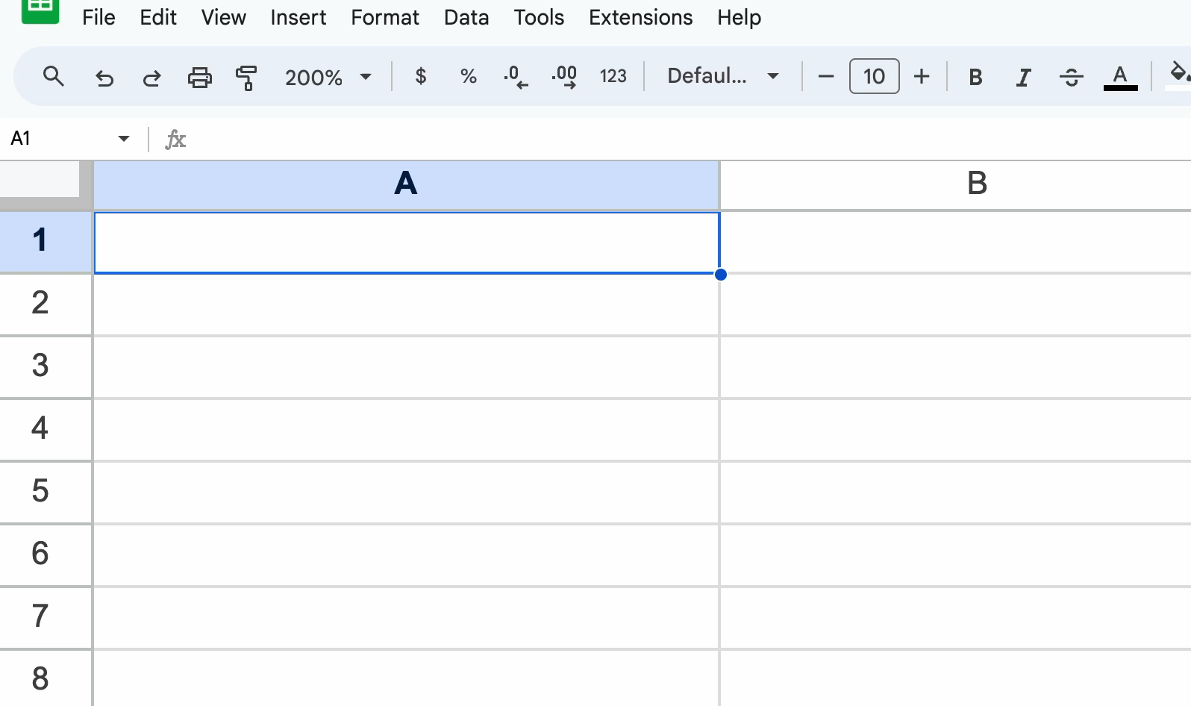

Slide 26
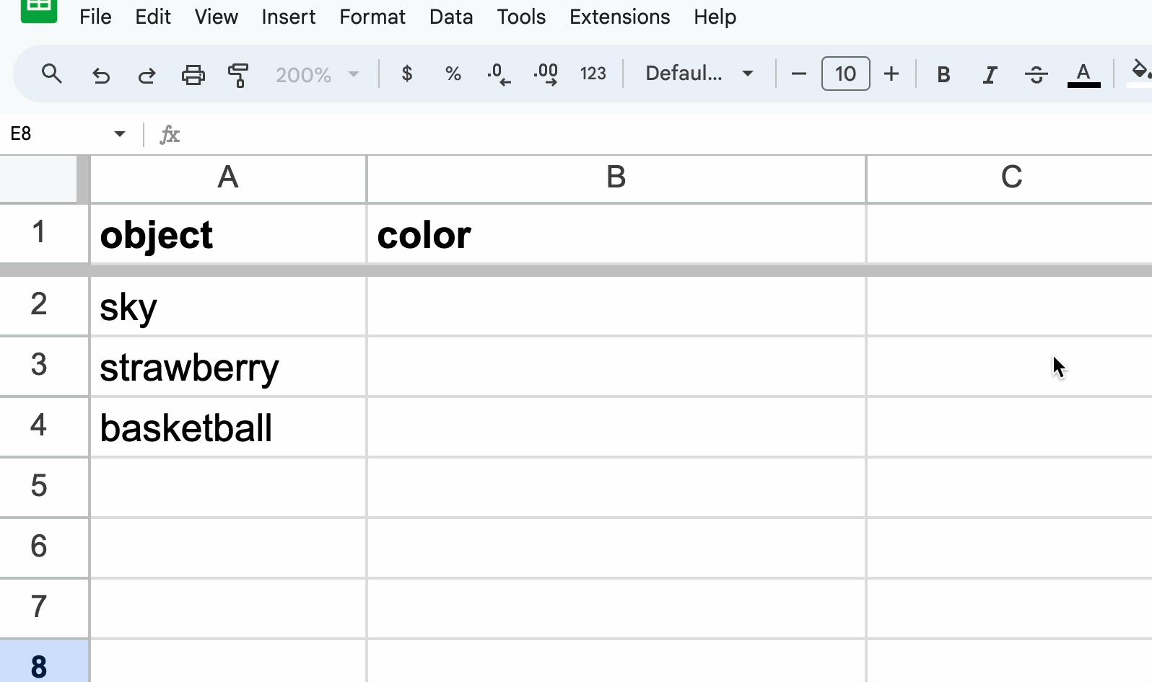

Slide 27
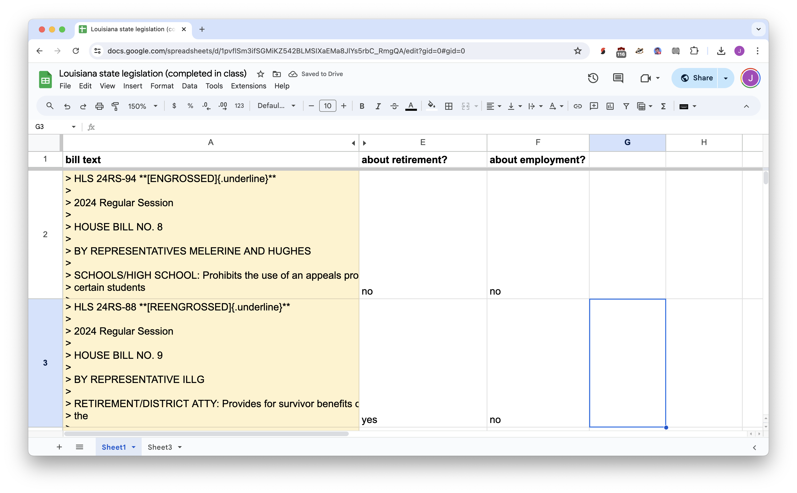



Slide 28





Slide 29
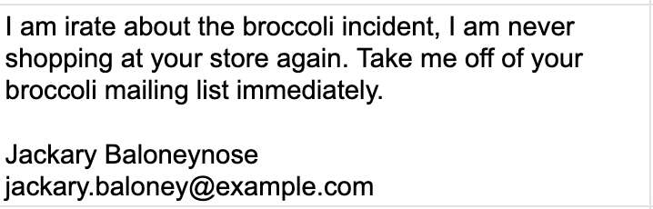

name
email

Slide 30
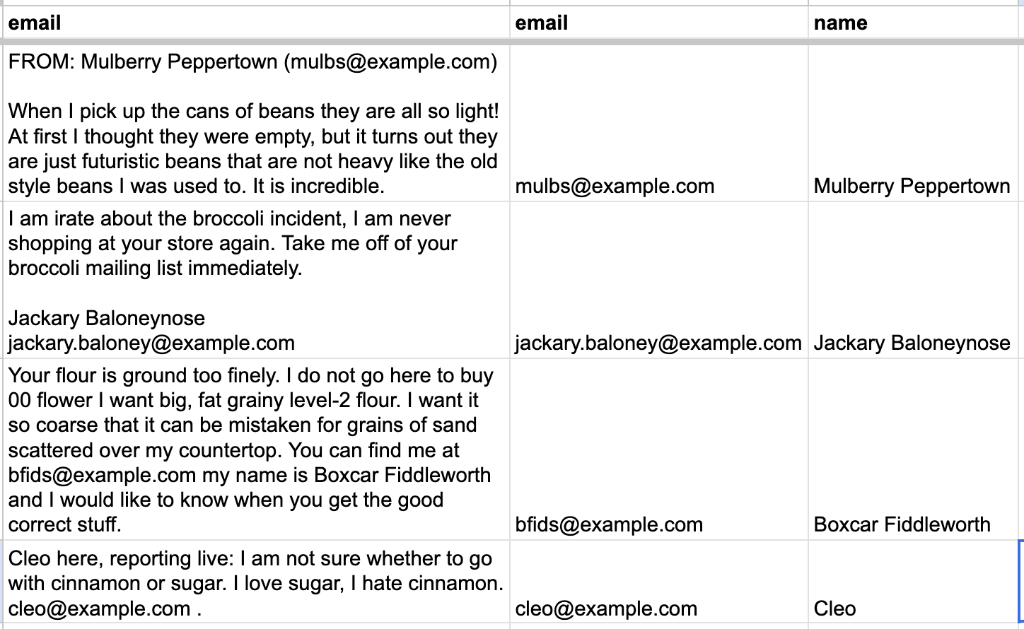


=CLAUDEEXTRACT(….)
“email”
“name”

Slide 31
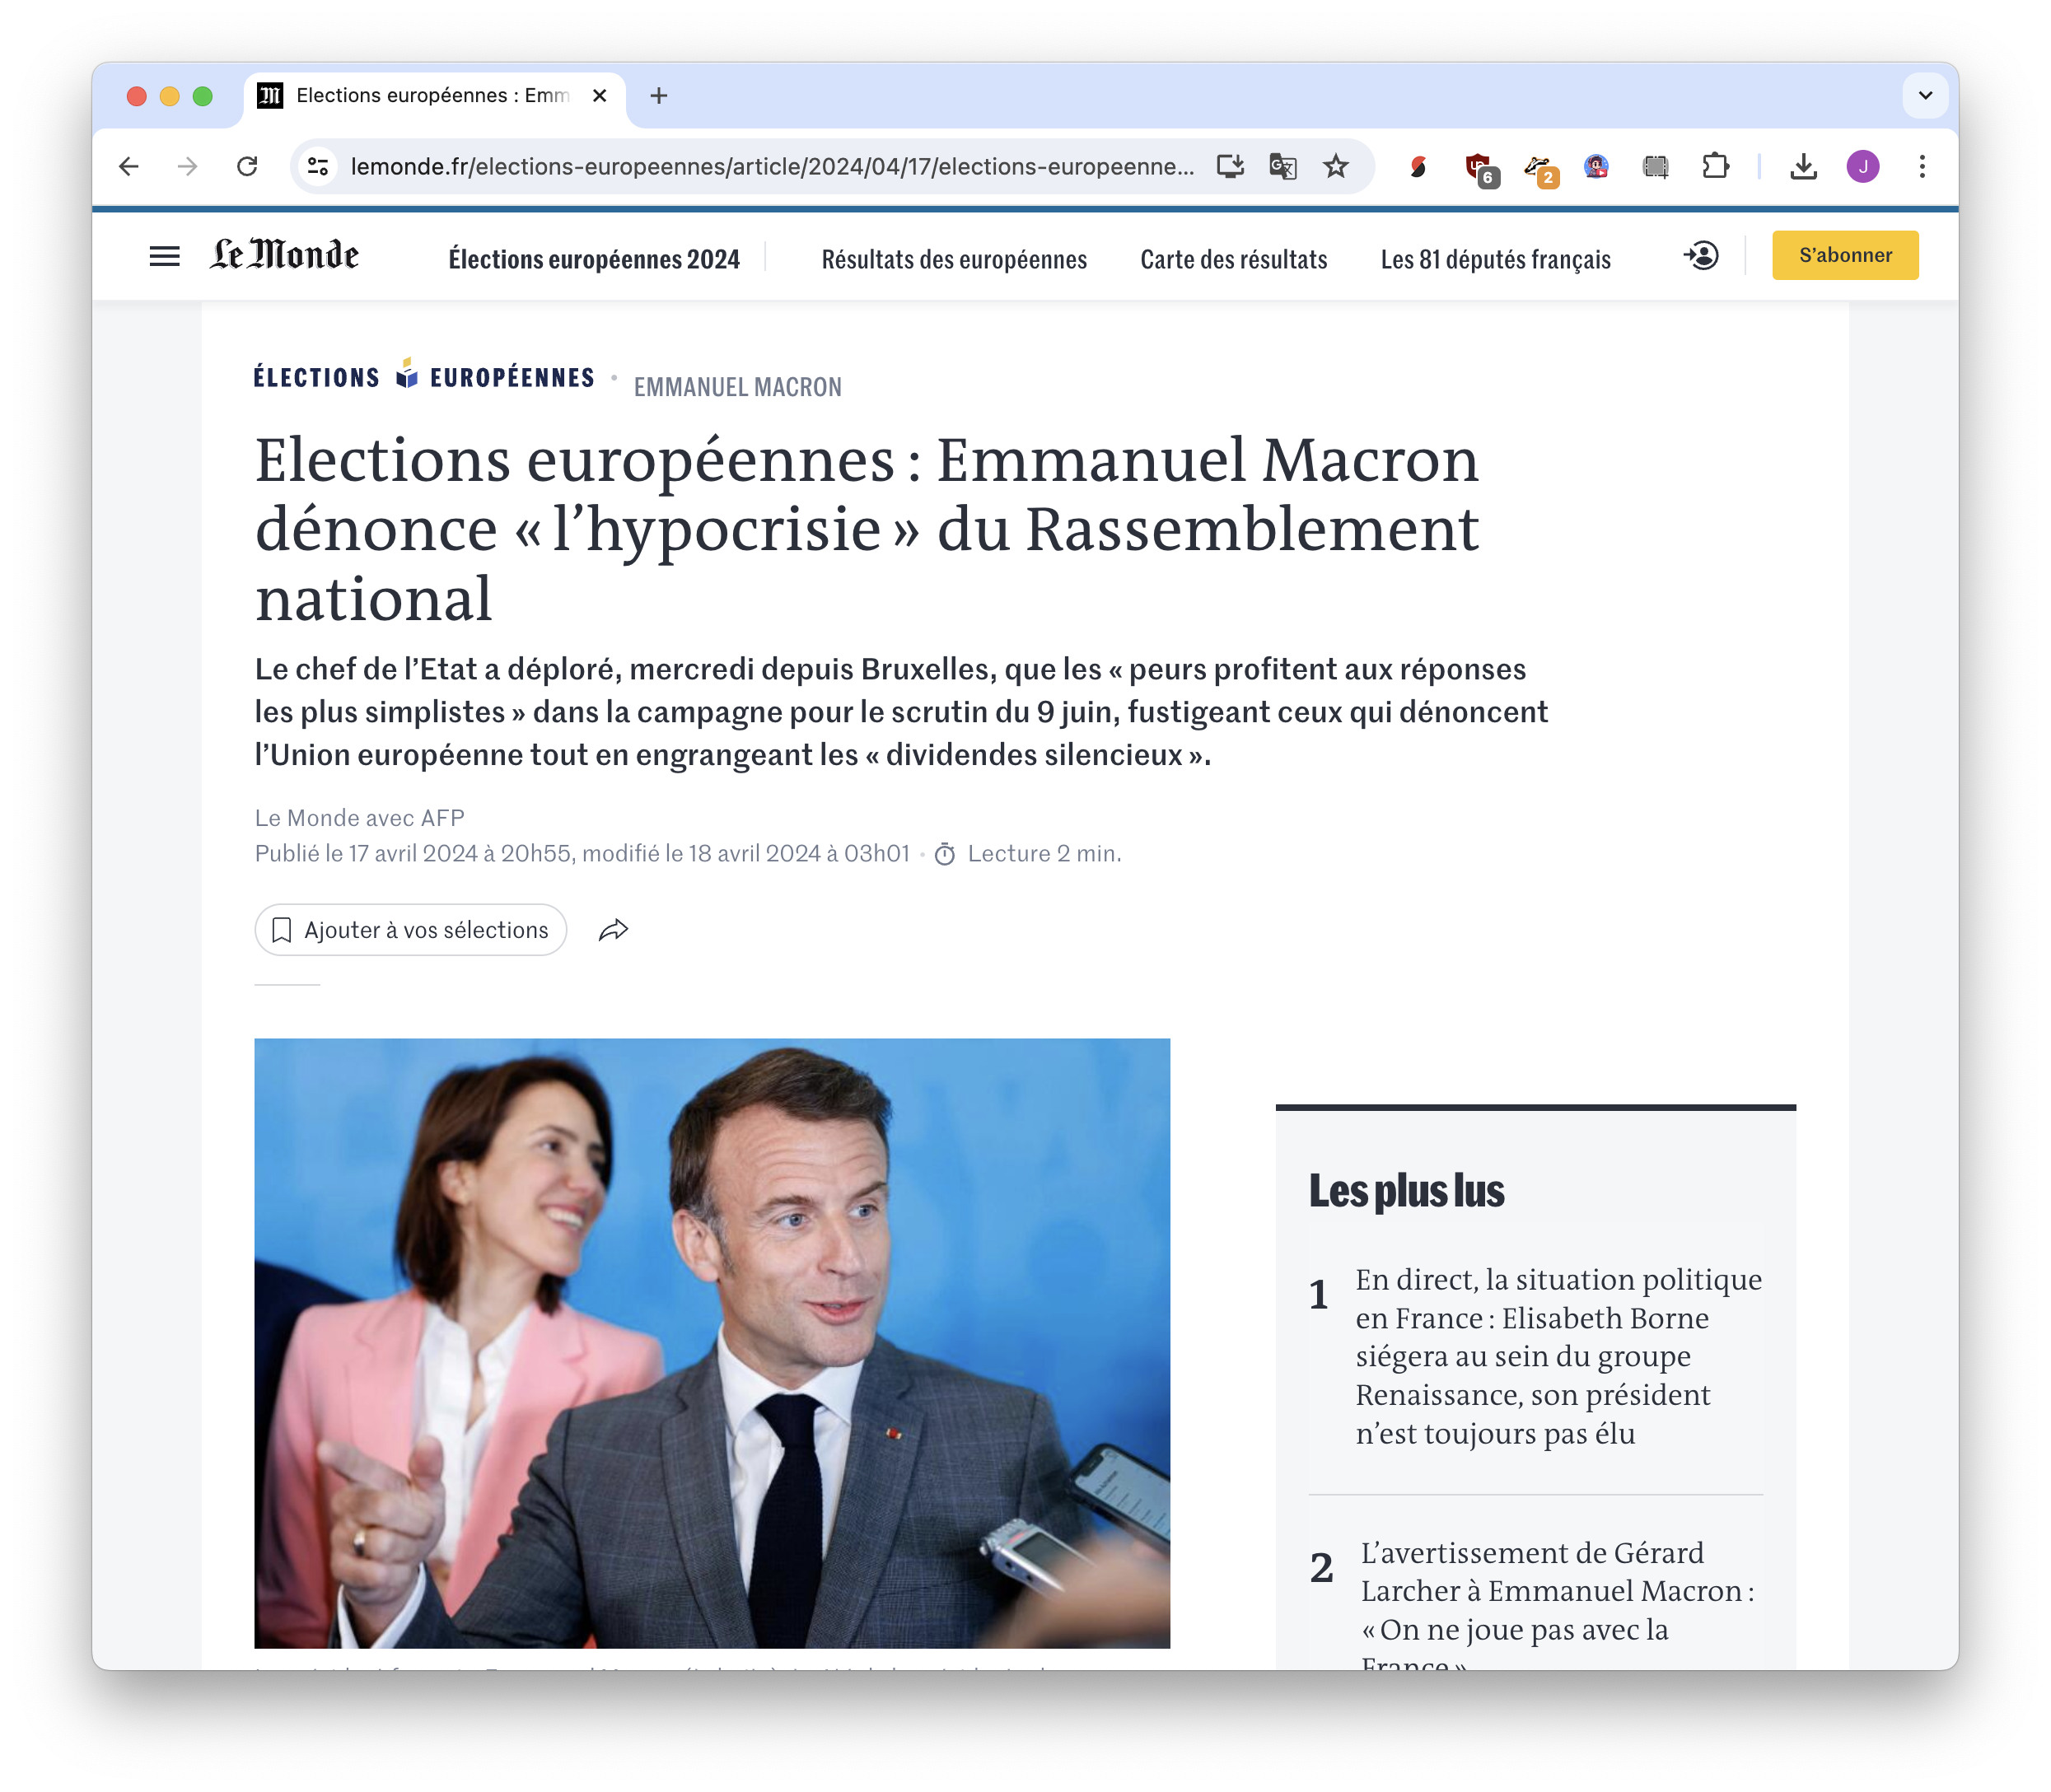
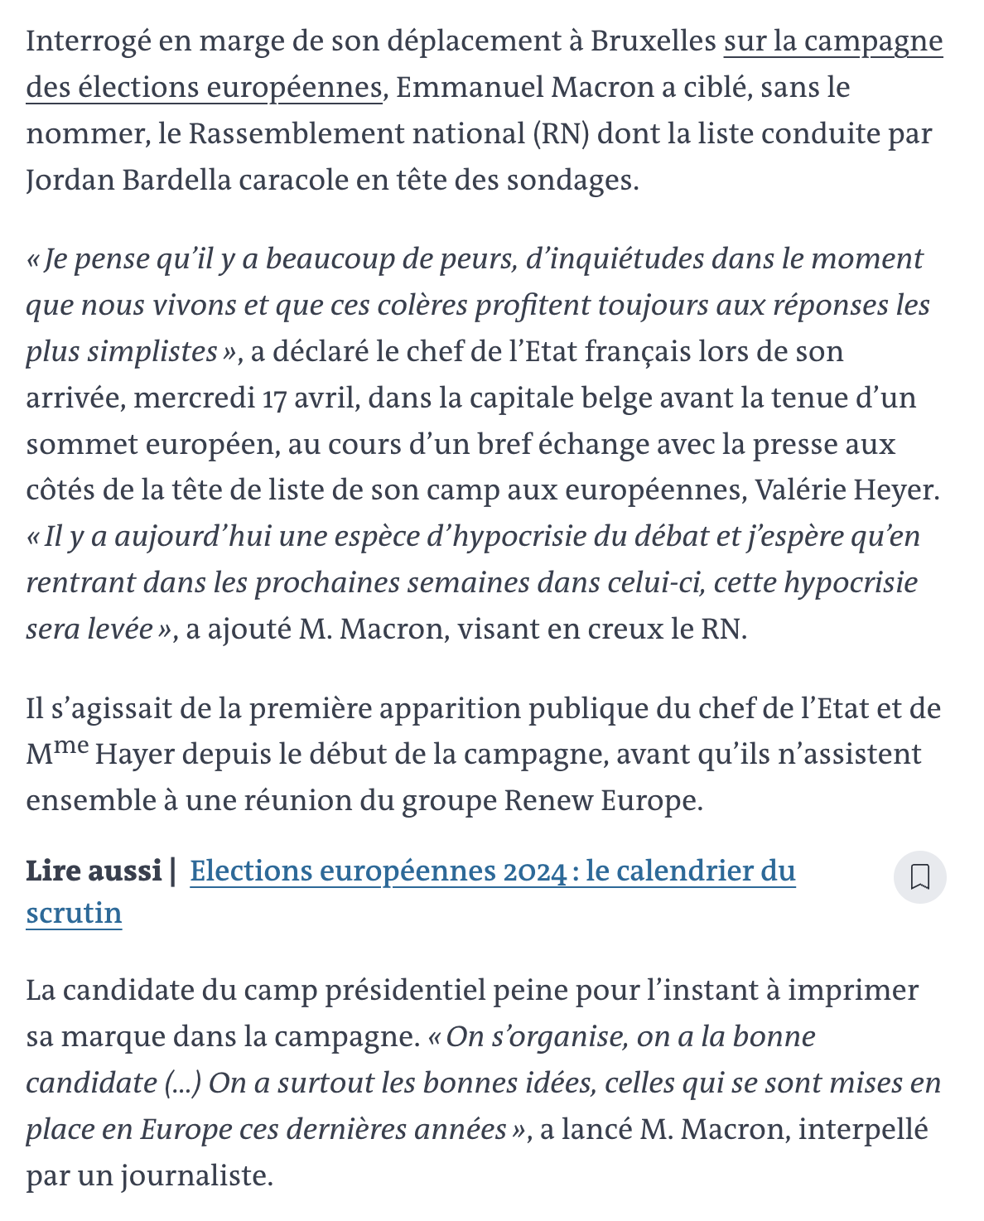

Slide 32
=CLAUDEEXTRACT("people mentioned in the article, with titles if available. One per line.", B5)
=CLAUDEEXTRACT("brief one-sentence summary", B5)
=CLAUDEEXTRACT("English translation", E5)
=CLAUDEEXTRACT("article category, one of politics, sports, international, other", B5)

Slide 33
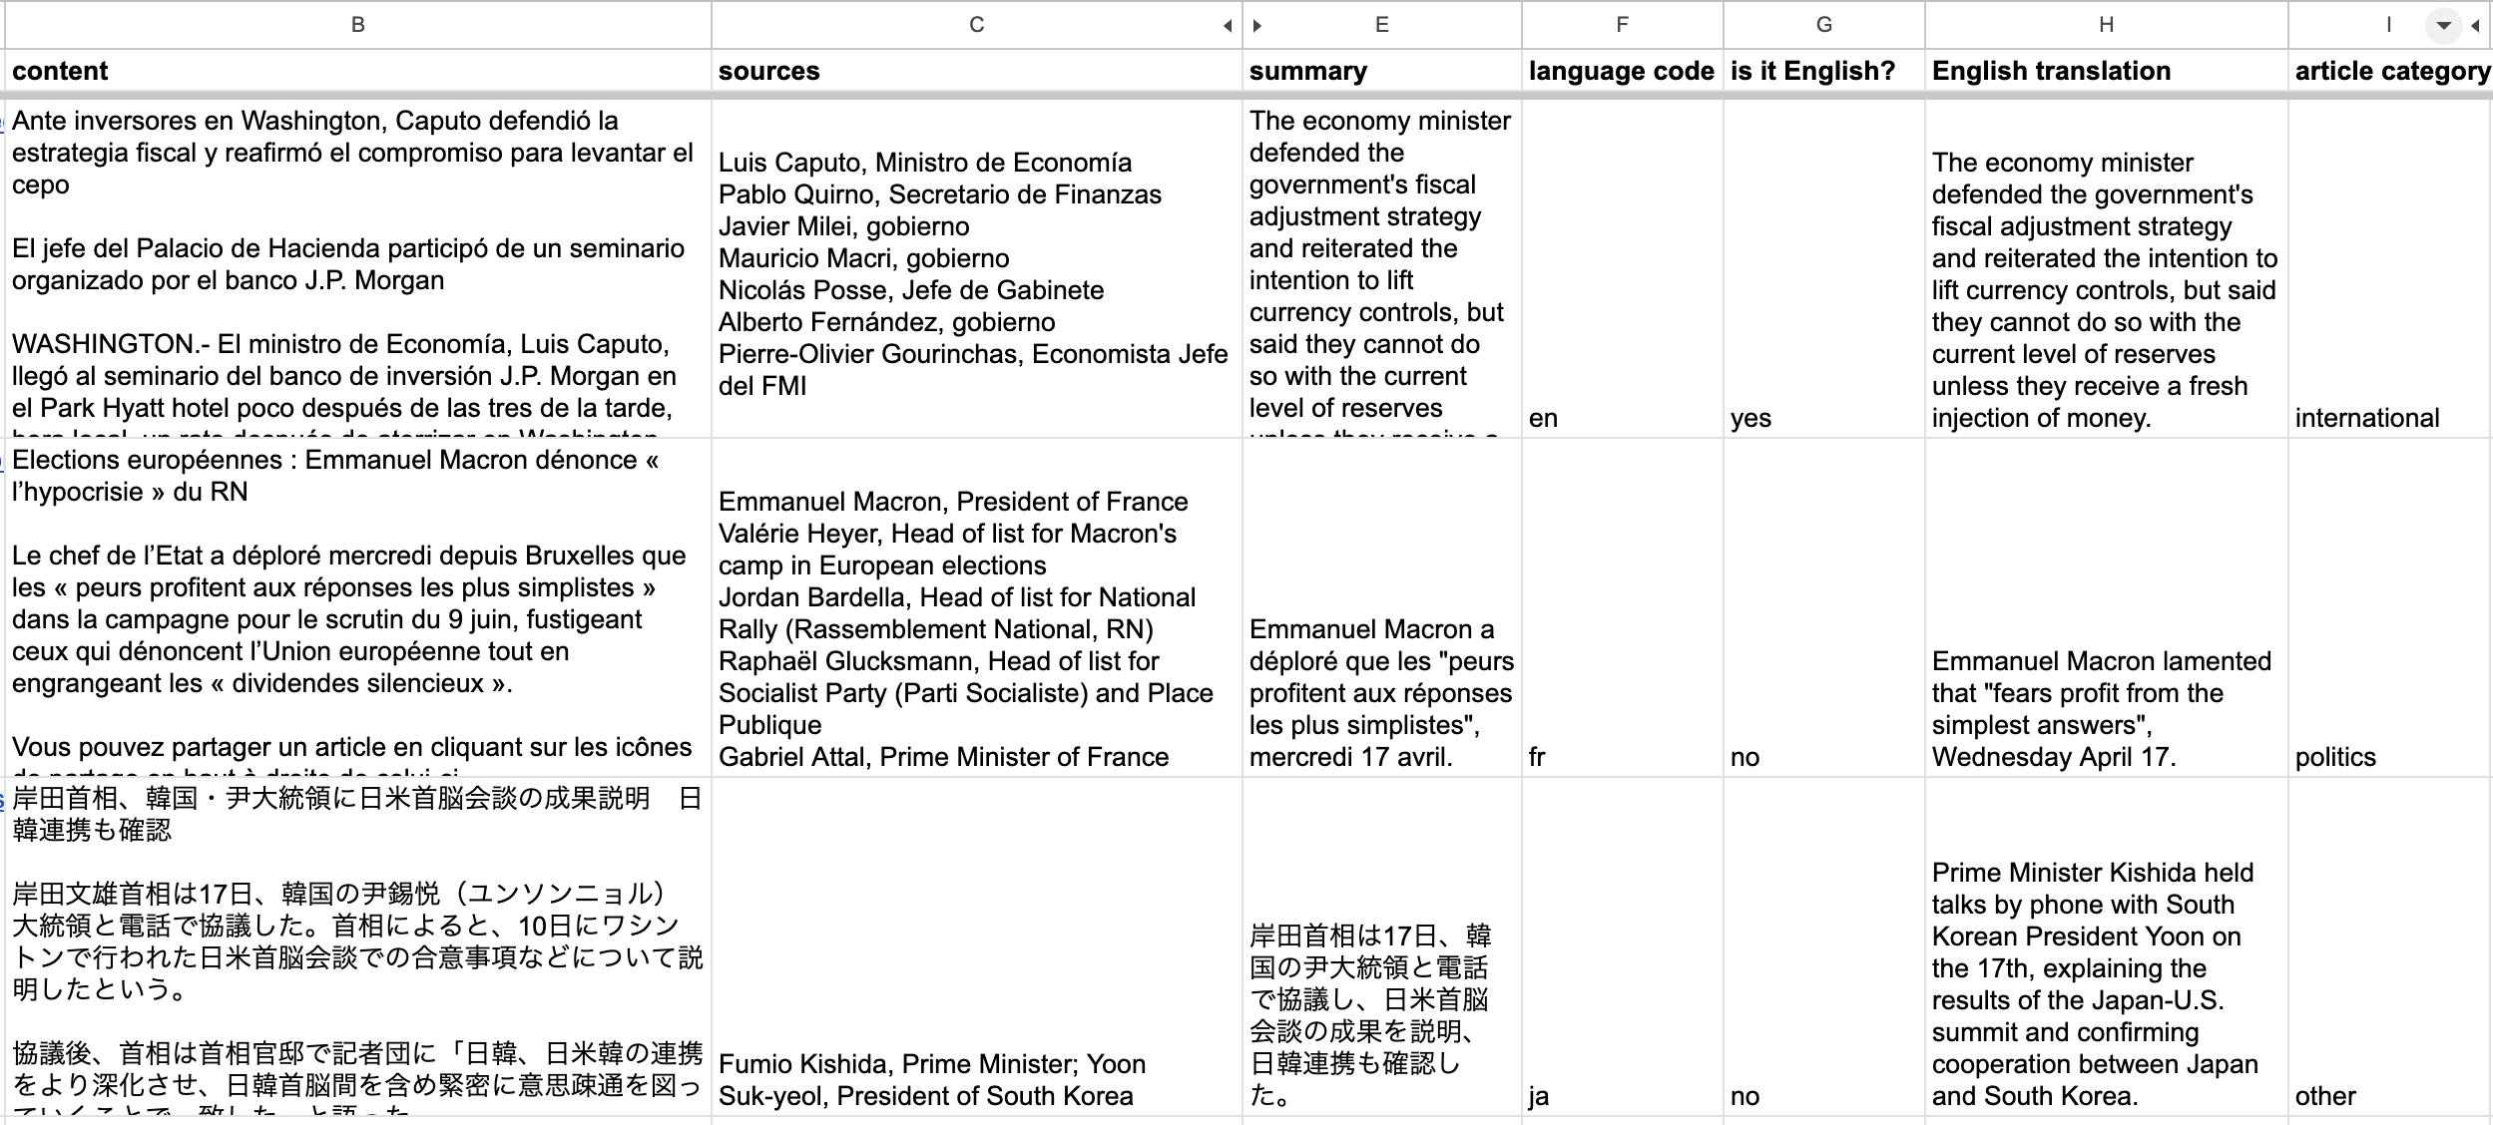

Notes:
And what was once one column of unstructured data is now broken out into a beautiful set of columns

Slide 34






















Notes:
and it’s really easy to check. People know how to use spreadsheets, they can see the content right there, you can sit down and see what your error rates are in like two minutes. Instead of listening to people who say “AI is always right” or “AI is always wrong” you can actually measure it now.

Slide 35
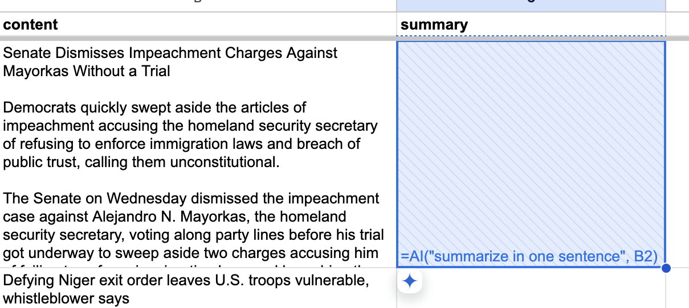
New from Google, =AI(…)

Slide 36
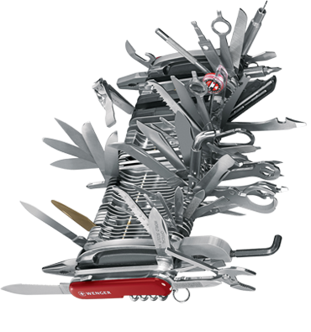



Generative AI chatbots are AI, but AI isn’t just chatbots.
AI has a discoverability problem
Notes:
You can’t just say “use AI,” you need specific tasks that resonate with those people to show them both the good and the bad

Slide 37










“AI”

Slide 38



model
input
output
Notes:
AI is models

Slide 39
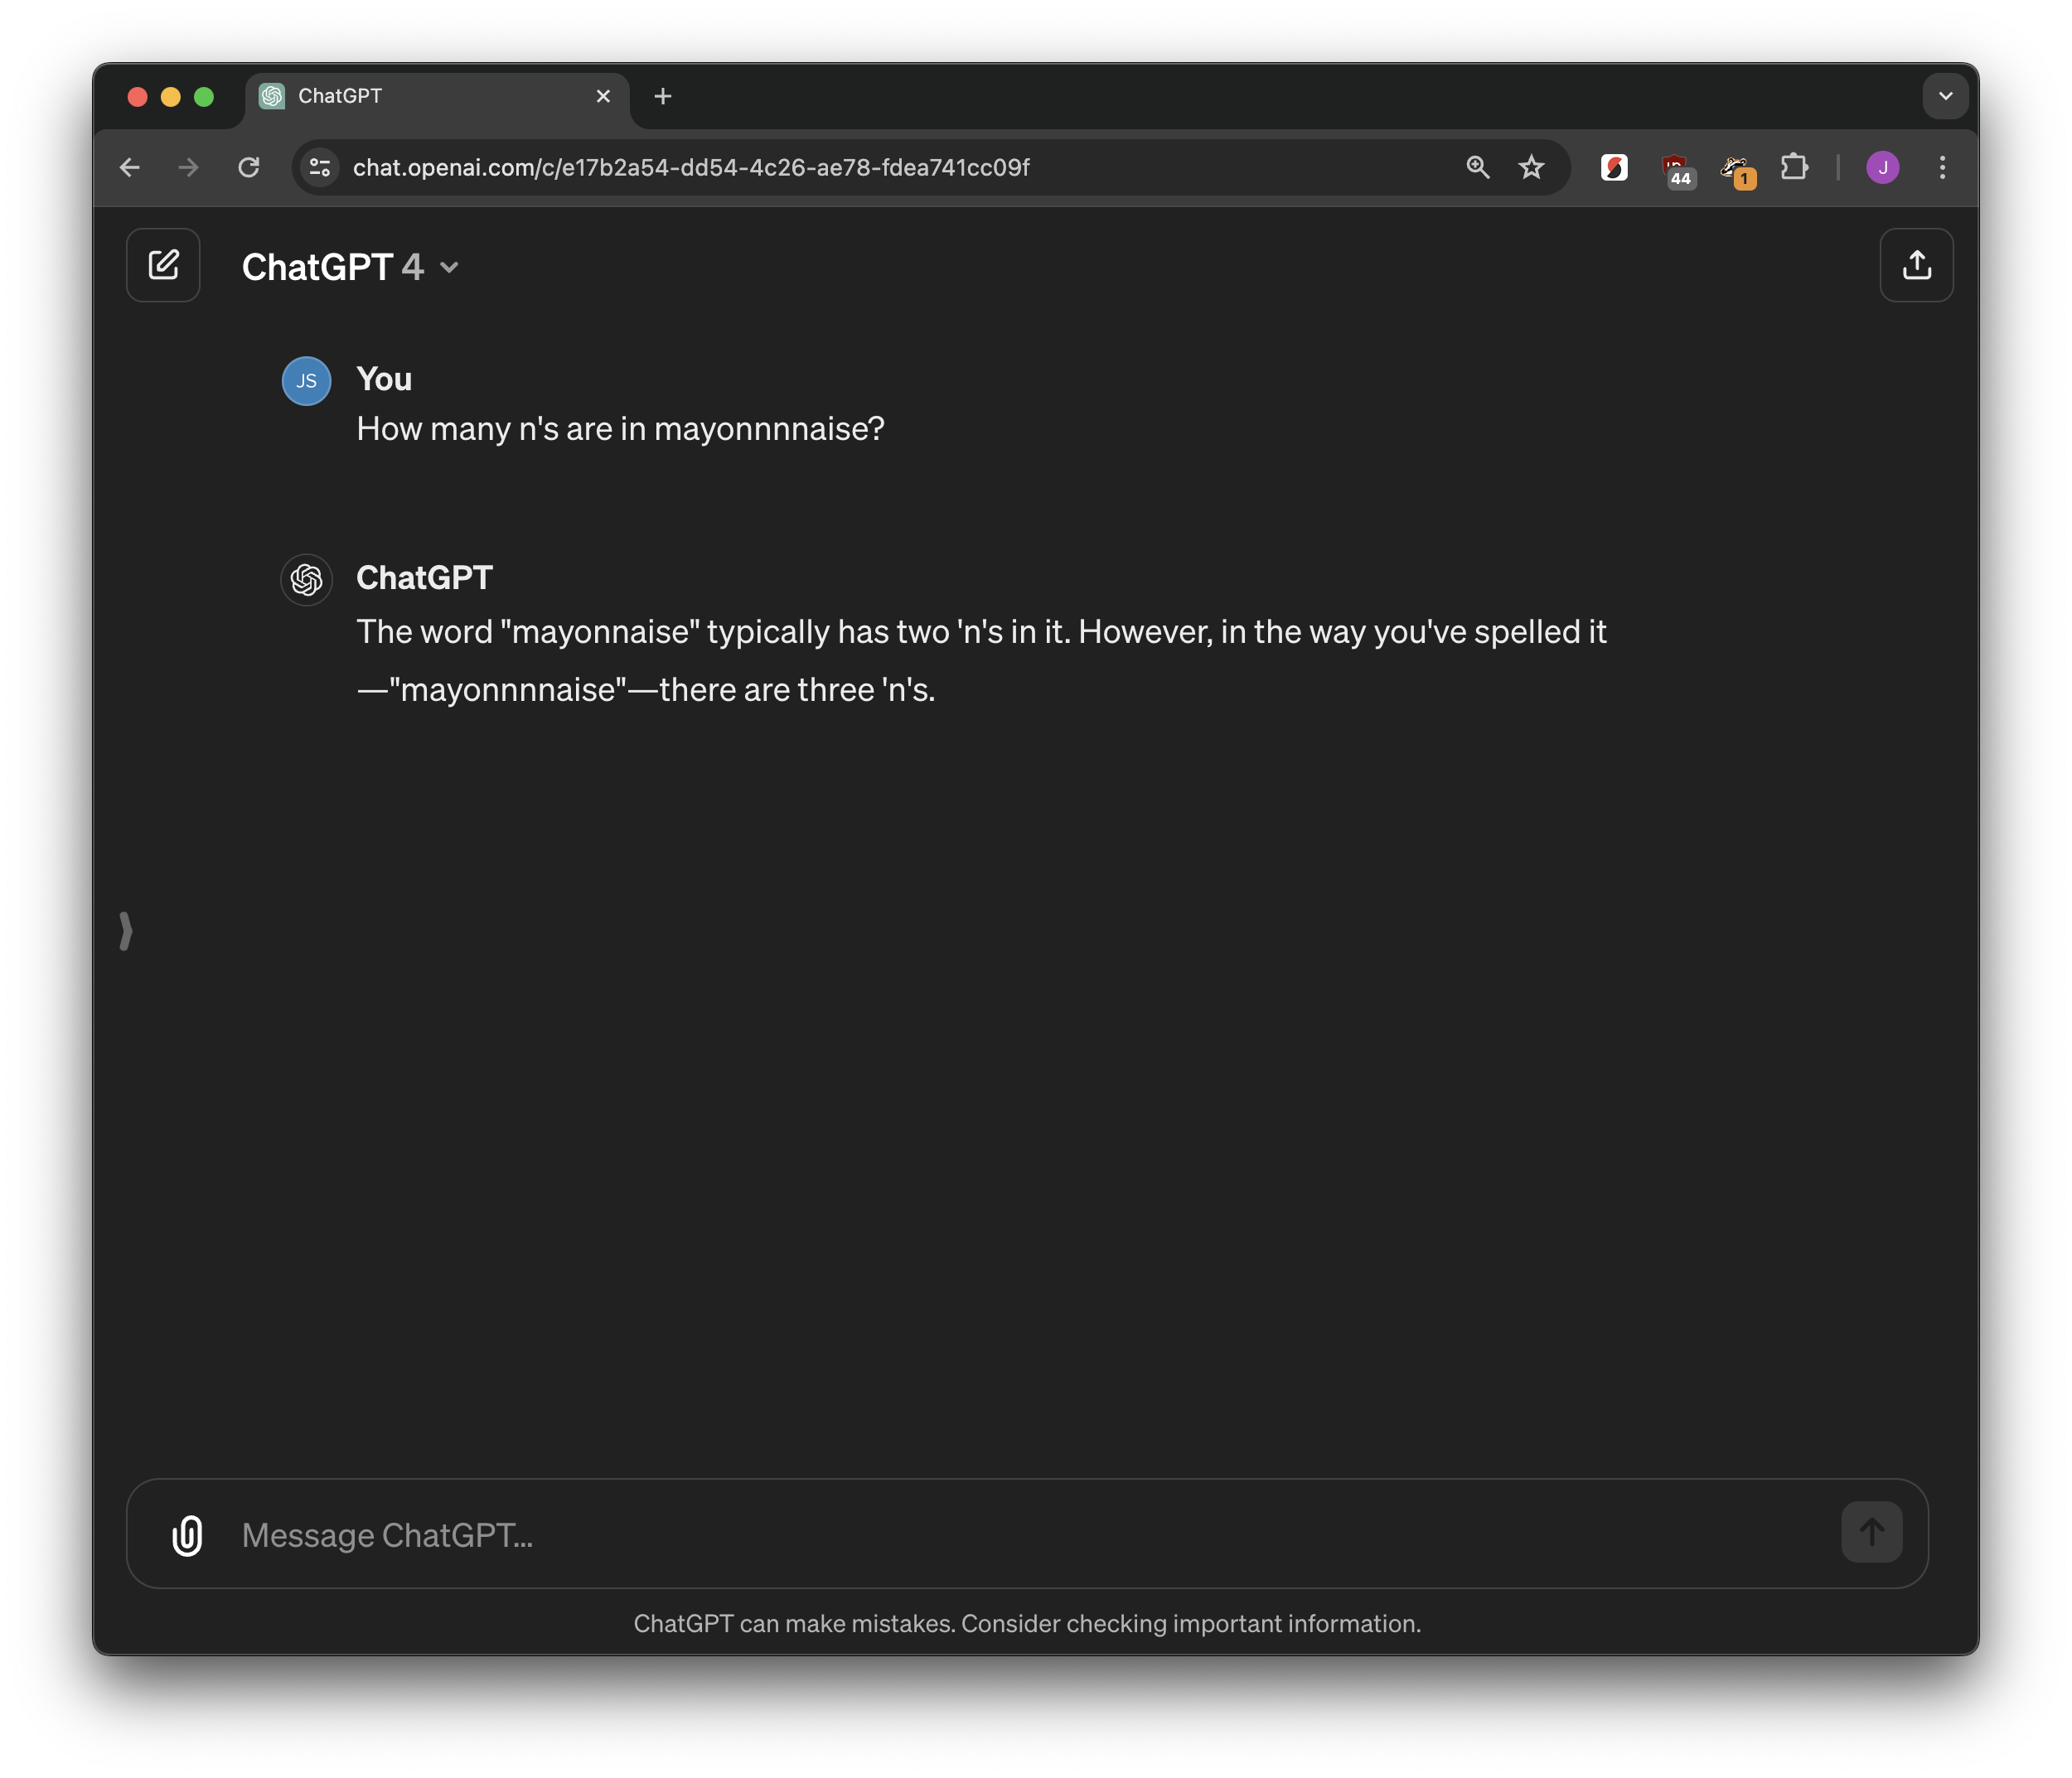
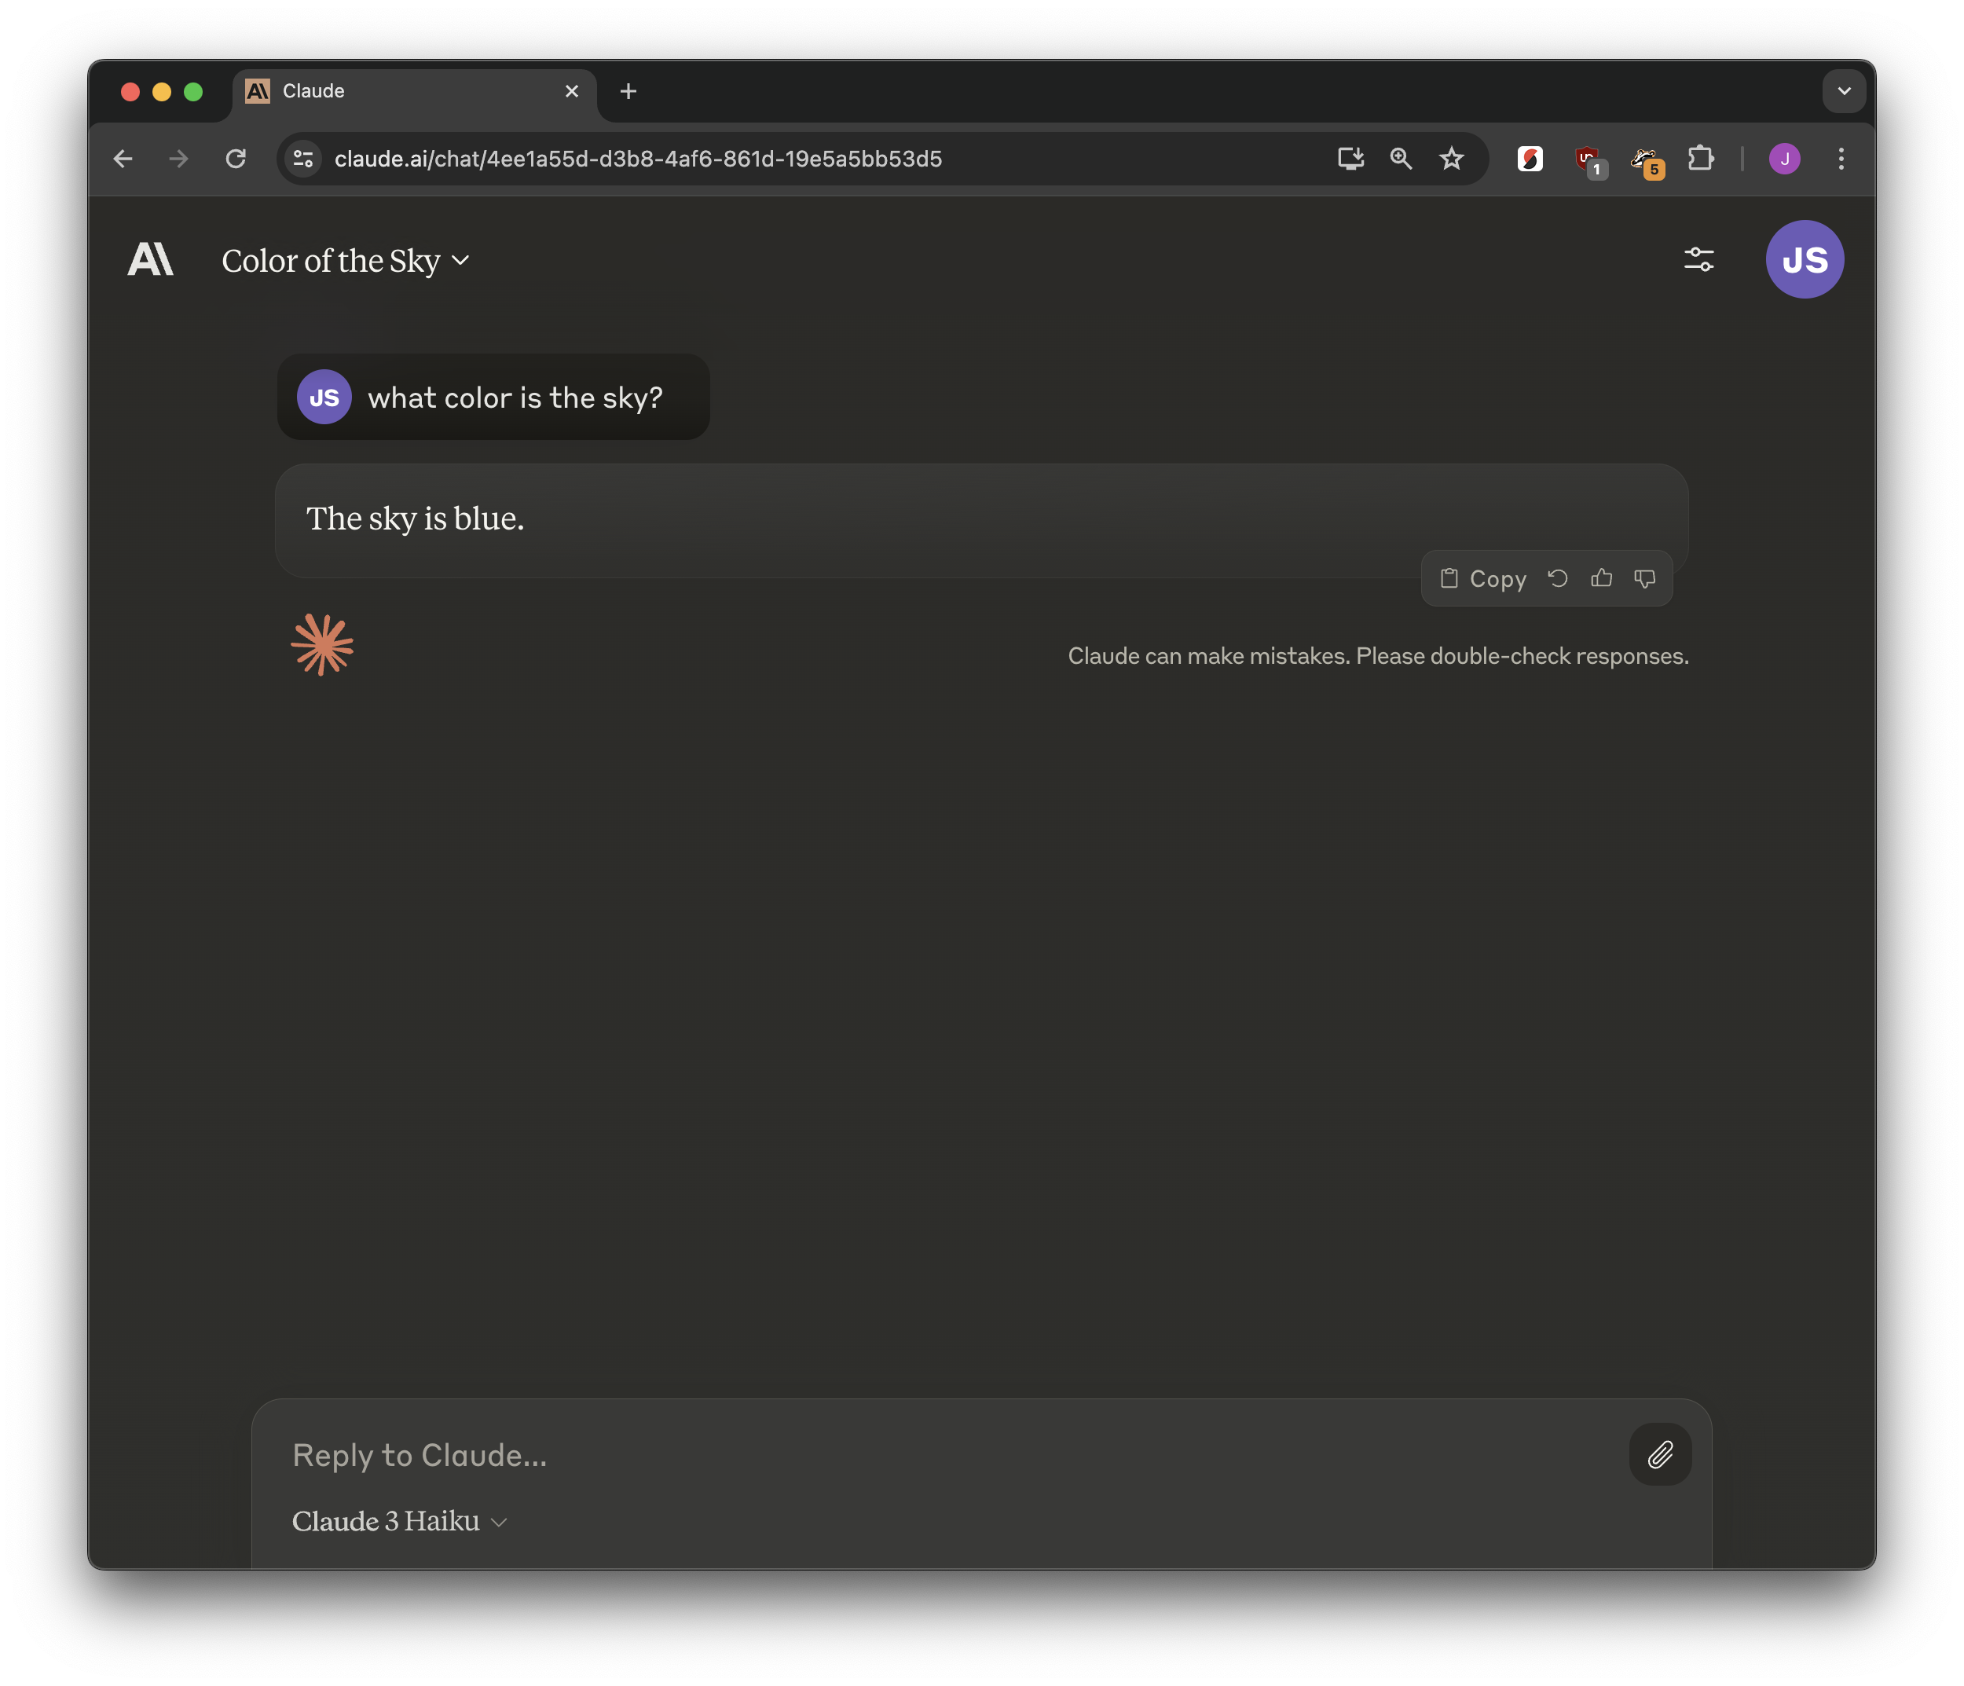



prompt
chat model
response

Slide 40
document
classification model
category

Slide 41

text
named entity recognition model
name
entities

Slide 42
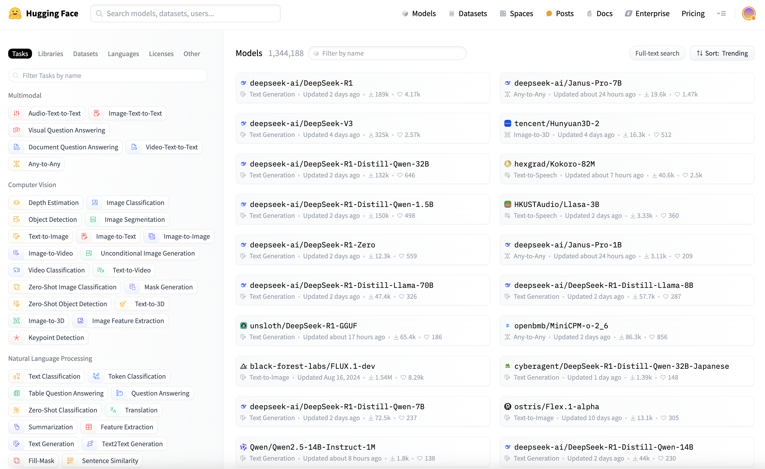

Hugging Face

Slide 43



Slide 44
Chatbots can almost do too much.
knowing the original tasks helps you understand what’s possible
Notes:
You can’t just say “use AI,” you need specific tasks that resonate with those people to show them both the good and the bad

Slide 45
A tool that does it for you: Google Pinpoint
Google Pinpoint is great at entity extraction and semantic (or fuzzy) search

Slide 46




Slide 47


Slide 48



Slide 49



Slide 50



Slide 51


Slide 52


Slide 53




Slide 54
But: semantic search has no “right” answers.
If I’m searching for “turkey”, does that match Istanbul? Syria? Lokum? Eric Adams? NYC? Eagle? Poultry? Farmhouse? It’s really just a rank.

Slide 55


Slide 56


Slide 57



Slide 58


Slide 59


Slide 60


Slide 61


Slide 62


Slide 63


Slide 65


Slide 66




Slide 67

audio
speech recognition model
text

Slide 68


Slide 69



Slide 70



Slide 71





Slide 72



Slide 73


Slide 74




Slide 75



Slide 76


Slide 77


Slide 78



Slide 79
“AI”

Slide 81
A.I.

Slide 82
Everyday AI!
https://bit.ly/soma-second-draft
Jonathan Soma
Knight Chair in Data Journalism
Columbia University Graduate School of Journalism
jonathansoma.com ⠿ @dangerscarf ⠿ js4571@columbia.edu

